Slide 1
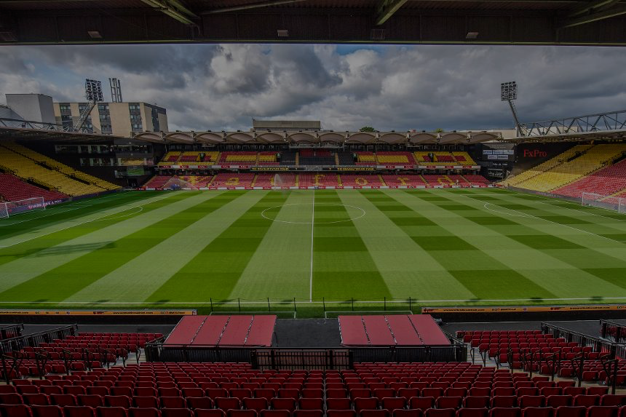
Edd Webster
Data Task
February 2022
Slides: docs.google.com/presentation/d/19DRC_23Od10nqDFkGUpSqALEwGSU1qt_XPRdl7VD9WU
Code: github.com/eddwebster/watford

Slide 2
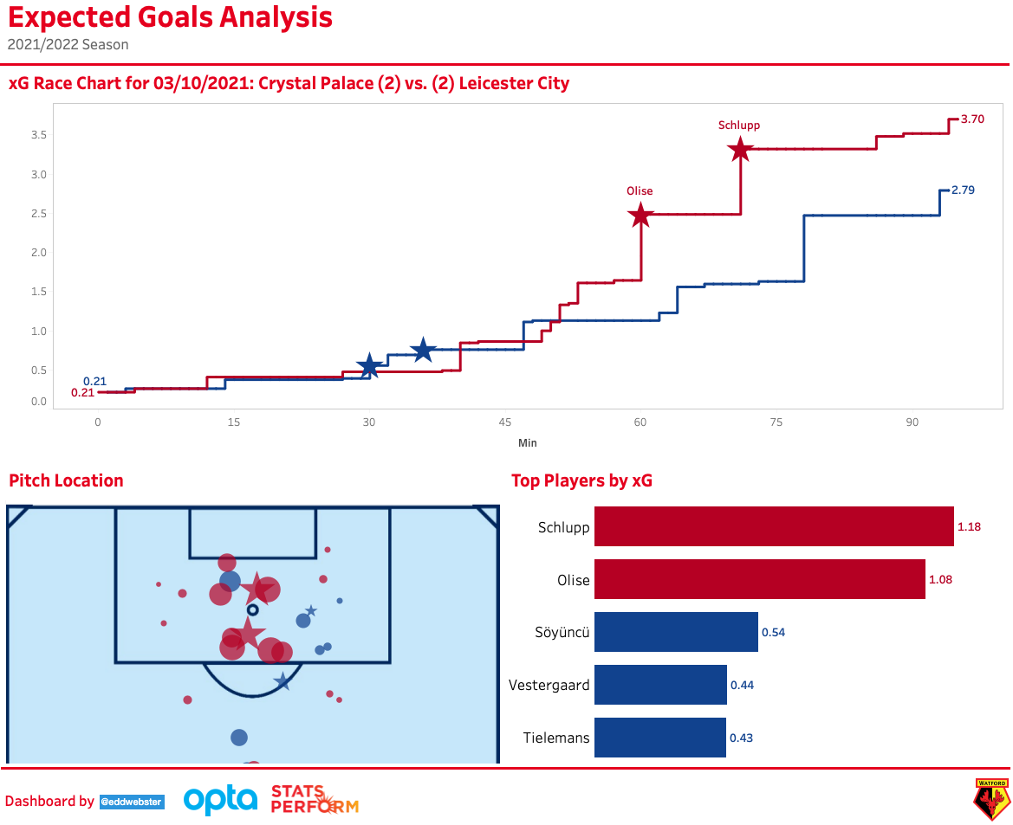
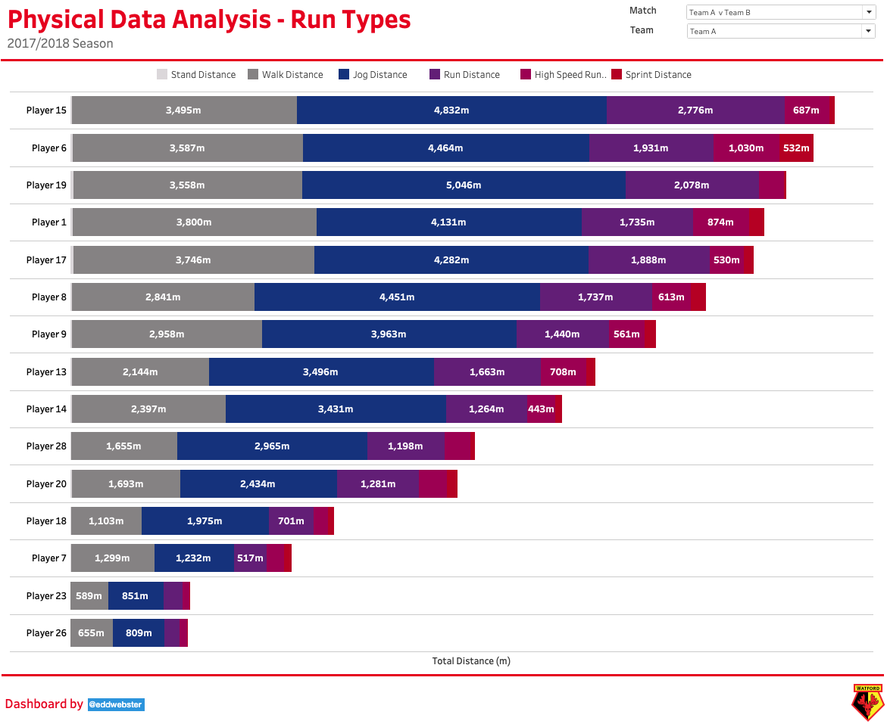
Contents
Introduction (slides 3-4)
Methodology (slides 5-8)
Part 1: Opposition Analysis of Crystal Palace (slides 9-28)
Part 2: Physical Data Analysis (slides 29-40)
Next Steps (slides 41-42)
Conclusion (slides 43-48)
Further work (slides 49-50)
References (slides 52-53)
Appendix (slides 53-61)
All code and data for the analysis featured in this pack: github.com/eddwebster/football_analytics and Tableau visualisations: public.tableau.com/profile/edd.webster.
Introduction
P1: Opposition Analysis
P2: Physical Data Analysis
Next Steps
Conclusion
Further Work
References
Appendix

Slide 3
Introduction
Introduction
P1: Opposition Analysis
P2: Physical Data Analysis
Next Steps
Conclusion
Further Work
References
Appendix

Slide 4
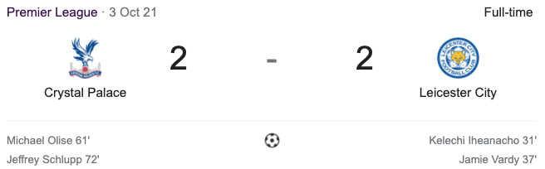
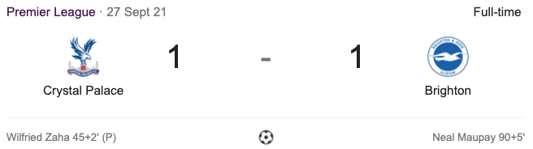
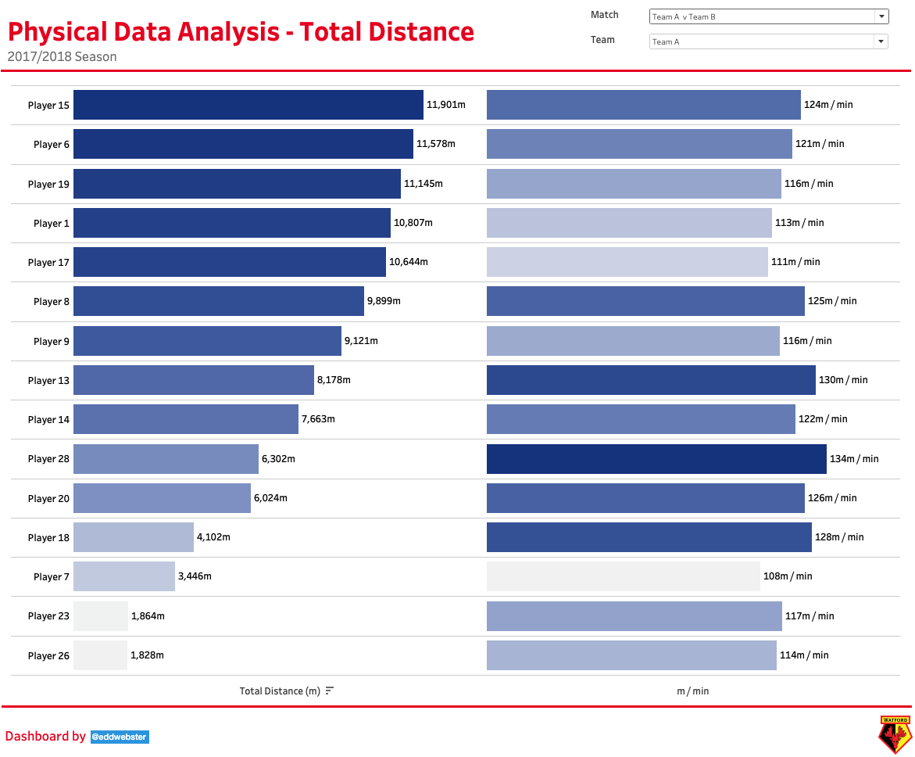
Task Brief
The task is structured in two parts
Part 1:
The first part is working with the either the Second Spectrum files or Opta files to create a data set to analyse Crystal Palace’s data, the Second Spectrum data is preferred.
A basic presentation of the data set would be needed as well as some basic insights from, you can use either the XML or JSON files, whichever you are more comfortable with.
Part 2:
The second part requires using the Physical Output CSV which is an anonymous seasons physical data from a historical season to provide insights on Team A as well as the other teams where relevant.
This should be done not only at team level but also at player level.
Introduction
P1: Opposition Analysis
P2: Physical Data Analysis
Next Steps
Conclusion
Further Work
References
Appendix

Slide 5
Methodology
Introduction
P1: Opposition Analysis
P2: Physical Data Analysis
Next Steps
Conclusion
Further Work
References
Appendix

Slide 6

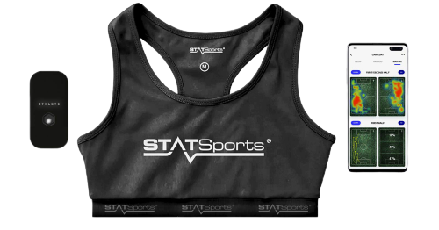

Data at the Disposal of this Task
The three datasets made available for this task
1
2
3
Event Data
Tracking Data
Physical Data
Log of each on-ball event
(passes/tackles/shots)
Examples: Event type, timestamp, spatial location, meta information of on-the-ball actions
O(10³) events per match
Used for Part 1
Player & ball positions
Samples at 25HZ
Examples: X, Y coordinates of the 22 players, 3 referees and the ball at every time-step
O(10⁶) observations per match
Used for Part 1
An anonymous seasons physical data from a historical season
Aggregated values for distance and speed, per player, per match
Dataset focusses on Team A only
Used for Part 2
Introduction
P1: Opposition Analysis
P2: Physical Data Analysis
Next Steps
Conclusion
Further Work
References
Appendix

Slide 7



Back-end Tools
Why Python has been selected for data engineering, preparation and modeling
The data preparation (back-end) has been conducted using Python in a Jupyter notebooks environment
Anaconda is open-source package of data science and machine learning tools, including Python and all the major libraries.
Python’s strength as a language come from the number of create packages and libraries available such as data munging and processing libraries like pandas, visualisation libraries such as matplotlib, machine learning libraries like scikit-learn and XGBoost, statistical analysis libraries such a statsmodels, fuzzy data matching libraries such as record-linkage, webscraping packages such as Beautifulsoup, and custom football analytics community such as the mplsoccer visualisation library, or code to parsed Event and Tracking data such as kloppy.
For these reasons, Python is the backend tool of choice used to construct this analysis pack, with the code to parse and engineer the data in this deck available at the following [link].
Introduction
P1: Opposition Analysis
P2: Physical Data Analysis
Next Steps
Conclusion
Further Work
References
Appendix

Slide 8

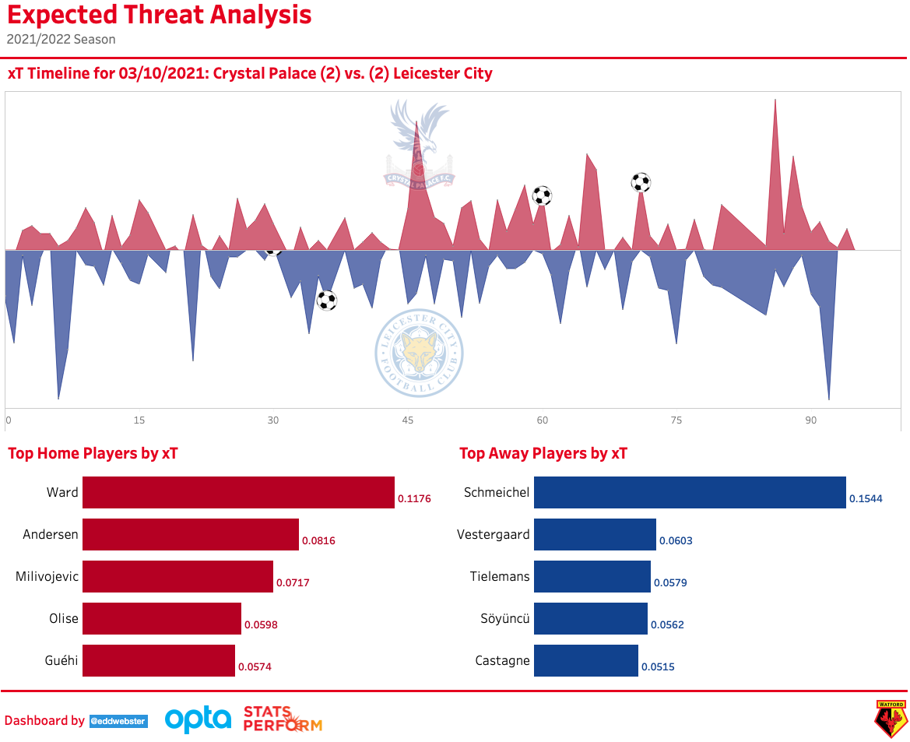
Front-end Tools
Why Tableau has been selected for data visualisation and analysis
Many of the front-end data visualisations have been created using Tableau.
For data analysis to be effective, it needs to be a part of the holistic approach of an organisation and be accessible not just to power users such as data analysts and data scientists. This is very applicable in an organisation, such as a football club, where functionality and accessibility to all levels of ability is of great importance. Through Tableau reporting, data can be made available to practitioners of every level of the organisation, such as sporting directors, head coaches, physios, analysts, and players.
The adaptability for Tableau to be used by beginners and power users alike, as well as the tool’s ability to reduce the users time to insight, is why I have selected it for visualisation.
Tableau Public profile: public.tableau.com/profile/edd.webster.
Introduction
P1: Opposition Analysis
P2: Physical Data Analysis
Next Steps
Conclusion
Further Work
References
Appendix

Slide 9
Opposition Analysis of Crystal Palace
using Event and Tracking data of two matches against Brighton & Hove Albion and Leicester City
Introduction
P1: Opposition Analysis
P2: Physical Data Analysis
Next Steps
Conclusion
Further Work
References
Appendix

Slide 10
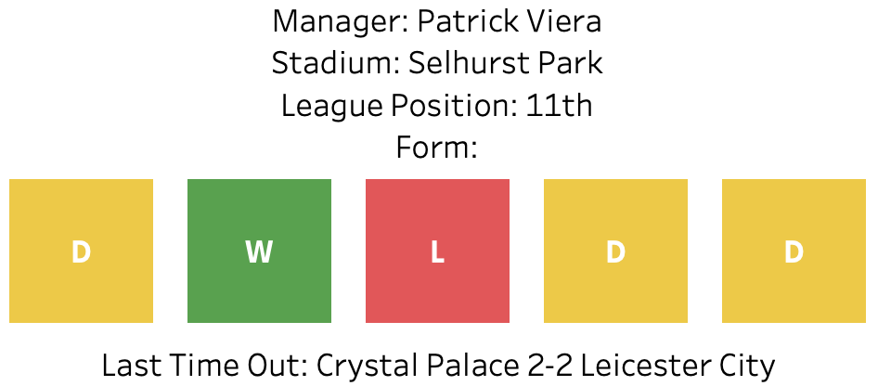





Crystal Palace Are a Team Beaten Only Once in the Last Five
Palace’s form guide in their five most recent Premier League games*
Visualisations created in the Form Guide Tableau Dashboard: public.tableau.com/app/profile/edd.webster/viz/EddWebsterWatfordF_C_-CrystalPalaceAnalysisandDashboard/FormGuideDashboard/
The most recent game being against Leicester City on 3rd October 2021.
Introduction
P1: Opposition Analysis
P2: Physical Data Analysis
Next Steps
Conclusion
Further Work
References
Appendix
Notes:
In this Opposition Analysis scenario, I am imagining that this analysis has been submitted in early October, after the most recent two fixtures against Brighton and Leicesterfrom the perspective of the upcoming opponent - Arsenal (played on 18th October after the first international break).

Slide 11
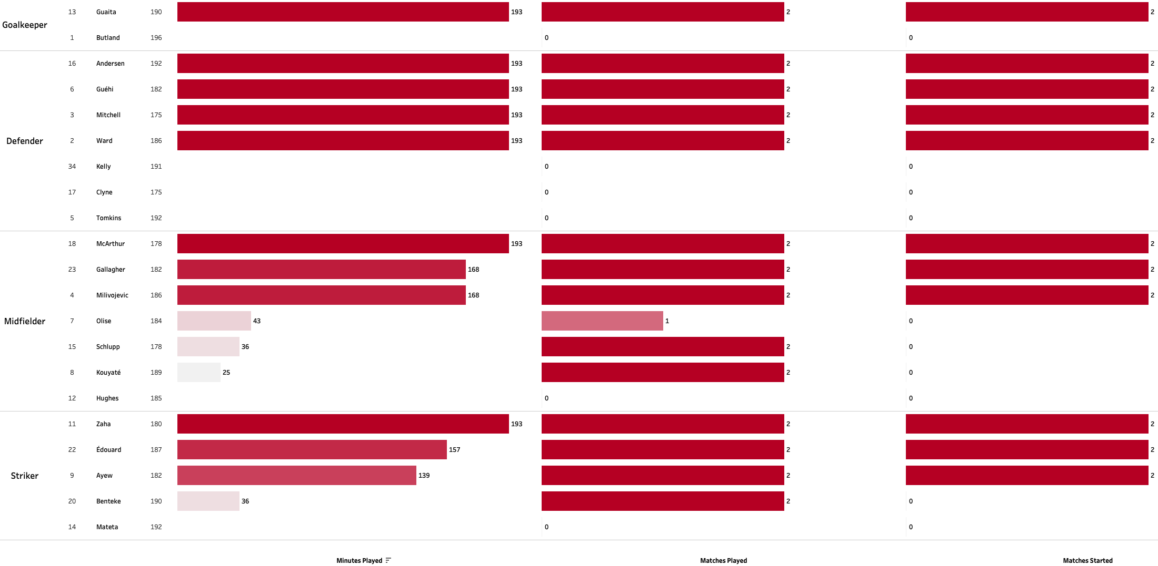
Crystal Palace Started the Same Team in Both Matches
Determining the most likely starting XI and substitutes from the player’s minutes in the two matches available
Visualisations created in the Squad List Tableau Dashboard: public.tableau.com/app/profile/edd.webster/viz/EddWebsterWatfordF_C_-CrystalPalaceAnalysisandDashboard/SquadListDashboard.
Introduction
P1: Opposition Analysis
P2: Physical Data Analysis
Next Steps
Conclusion
Further Work
References
Appendix
Notes:
Same starting XI
Against Brighton, Palace brough on Kouyate, Schlupp, and Benteke
Against Leicester they brought on Olise, Schlupp and Benteke

Slide 12
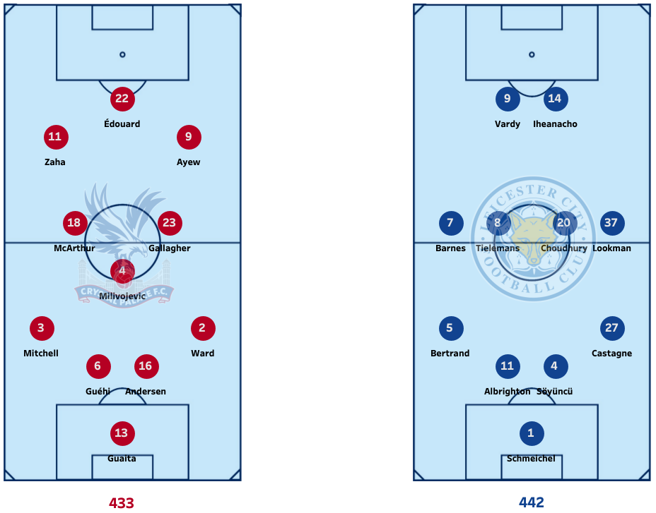
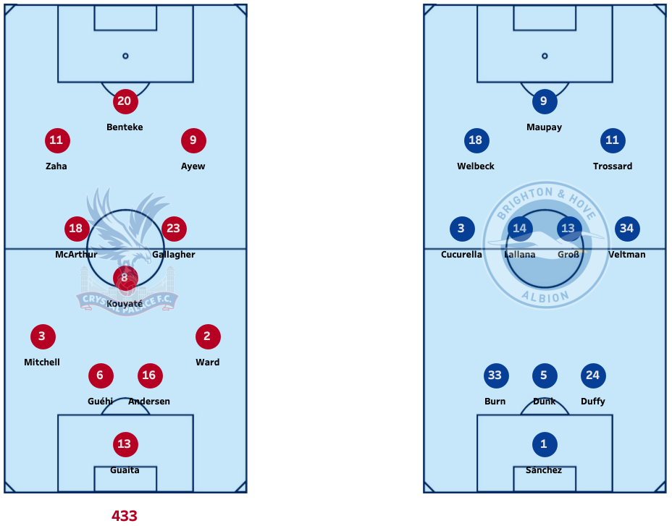
Crystal Palace Favour Playing a 4-3-3
They opted to play the same formation and starting XI in both games
Visualisations created in the Formations Analysis Tableau Dashboard: public.tableau.com/app/profile/edd.webster/viz/EddWebsterWatfordF_C_-CrystalPalaceAnalysisandDashboard/FormationAnalysisDashboard.
Introduction
P1: Opposition Analysis
P2: Physical Data Analysis
Next Steps
Conclusion
Further Work
References
Appendix

Slide 13
Strengths and Weaknesses of Playing in a 4-3-3
Strengths
Provides a good balance for the three central midfielders and the addition of a defensive midfielder allows for added balance - Kouyaté or Milivojević.
The system creates natural passing angles (triangles/diamonds), to progress play.
The formation can be naturally flexible and adapt to specific match situations, able to shift to a 3-2-5 in-possession and a 4-1-4-1 out-of-possession.
Weaknesses
The full-backs can become isolated if the wingers are not disciplined in the defensive transition and when out of possession.
A lack of a ‘number 10’ can mean the supply from midfield to forwards becomes disjointed, a shift to 4-2-3-1 can stop this.
The center forward can become isolated if the team operates in a 4-5-1 low block when out-of-possession.
Tactical information courtesy of Russell Pope. See his football formations and strategies eBook: drive.google.com/file/d/1pLAETNVUf4Qwe5jRasCUNdxwVgngEiOK/.:
Introduction
P1: Opposition Analysis
P2: Physical Data Analysis
Next Steps
Conclusion
Further Work
References
Appendix

Slide 14
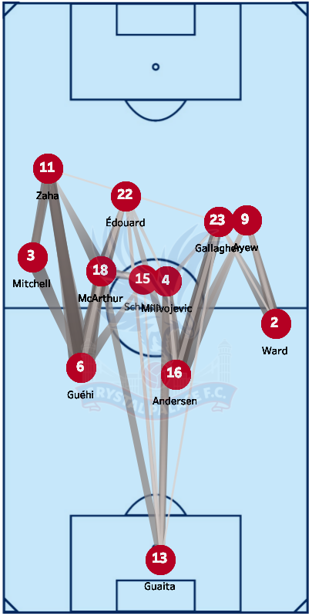
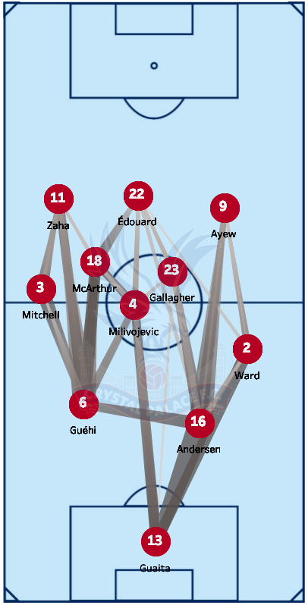
The Center Backs Like to Get the Ball Forward to the Wingers
Analysis of the Passing Networks for Palace’s Starting XIs in each game
Visualisations created in the Passing Networks Tableau Dashboard: public.tableau.com/app/profile/edd.webster/viz/EddWebsterWatfordF_C_-CrystalPalaceAnalysisandDashboard/PassingNetworkDashboard.
Introduction
P1: Opposition Analysis
P2: Physical Data Analysis
Next Steps
Conclusion
Further Work
References
Appendix
Notes:
Attacking threat comes from the left-hand-side. Mitchell plays high and wide up as the full-back and Zaha is their main outlet
The center backs will often deliver the ball directly into the wingers – Zaha and Ayew

Slide 15
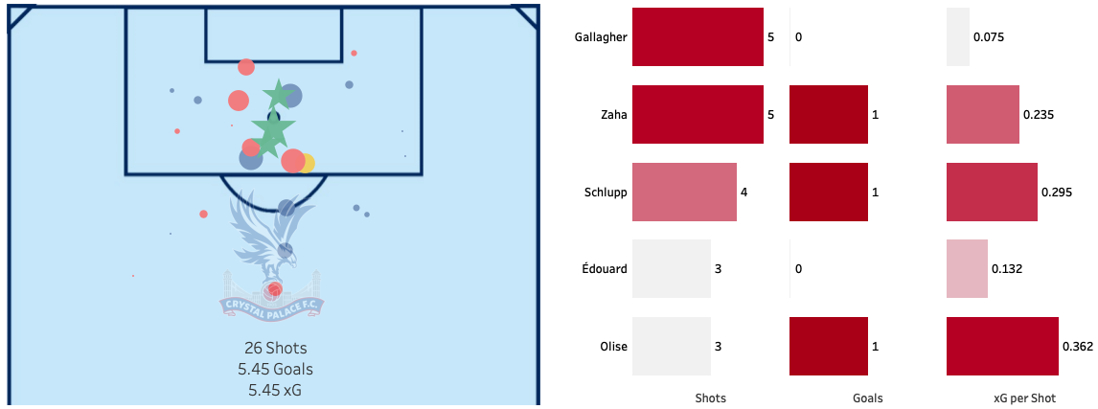
Zaha, Schlupp, and Olise Shared Crystal Palace’s Three Goals
Measuring the Shots, Goals, and xG per Shot of Palace’s most attacking players, including the shot locations
Visualisations created in the Team Chance Creation Analysis Dashboard: public.tableau.com/app/profile/edd.webster/viz/EddWebsterWatfordF_C_-CrystalPalaceAnalysisandDashboard/TeamChanceCreationAnalysisDashboard
`xG explained by FBref: fbref.com/en/expected-goals-model-explained/
Expected Goals model trained on the Event data of Premier League shots between 2009/10-2020/21.
Introduction
P1: Opposition Analysis
P2: Physical Data Analysis
Next Steps
Conclusion
Further Work
References
Appendix

Slide 16
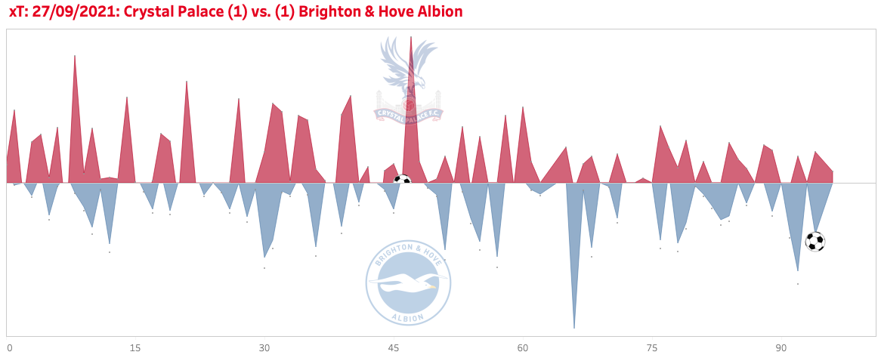
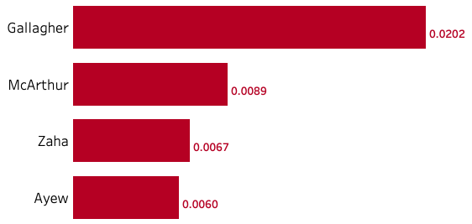
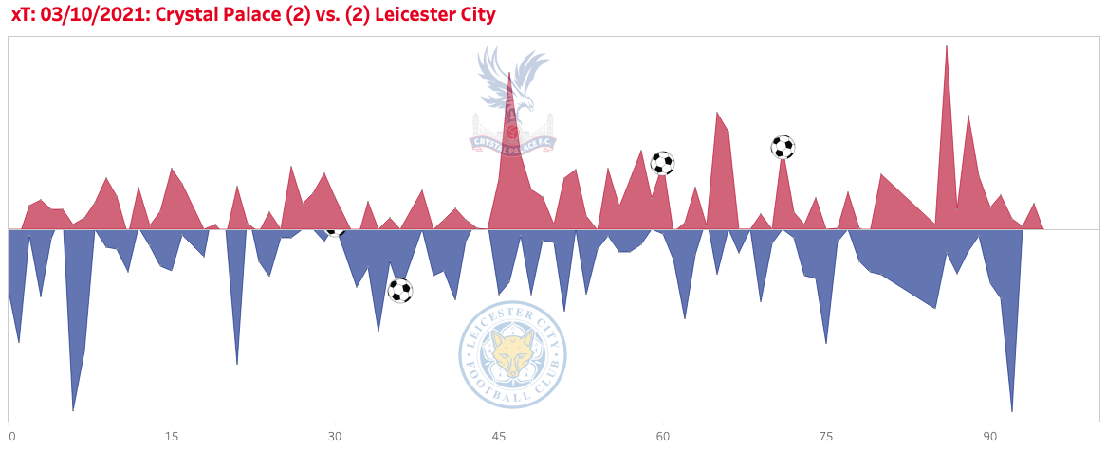
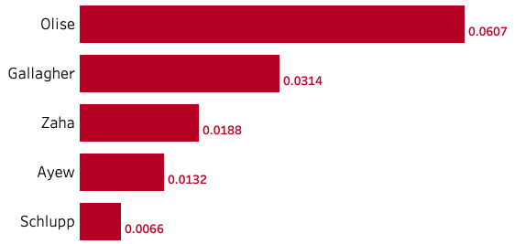
Gallagher and Zaha Posed Palace’s Greatest Threat Going Forwards
Measuring the creation of attacking chances using Expected Threat (xT) of the midfielders and forwards
Visualisations created in the xT Analysis Tableau Dashboard: public.tableau.com/app/profile/edd.webster/viz/EddWebsterWatfordF_C_-CrystalPalaceAnalysisandDashboard/xTAnalysisDashboard.
Expected Threat (xT) calculated from the Event data.
Introduction
P1: Opposition Analysis
P2: Physical Data Analysis
Next Steps
Conclusion
Further Work
References
Appendix

Slide 17
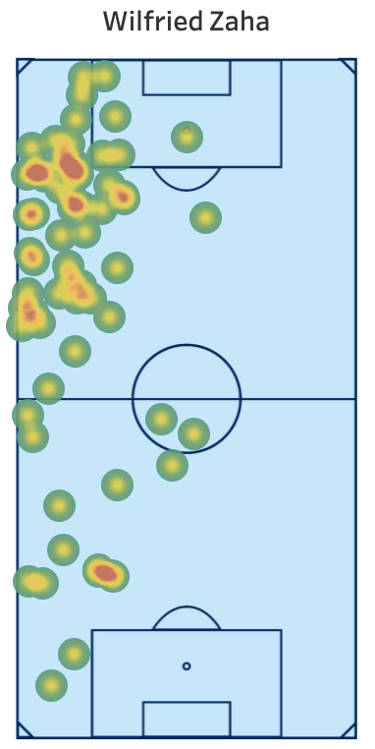
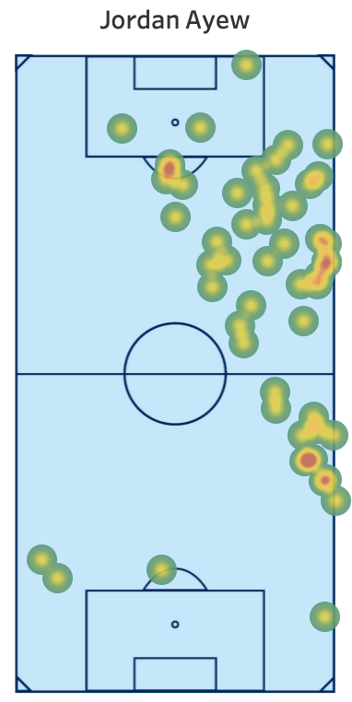
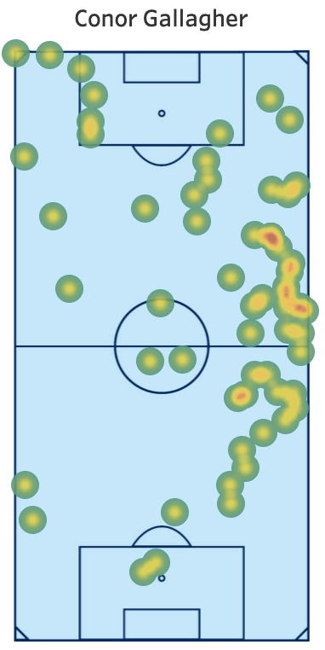
The Wingers Affect the Game Out Wide and Gallagher Works from the RHS of Midfield
Analysing the touches of Palace’s players to watch, with the attacking threat coming from the flanks
Visualisations created in the Touch Heat Map Tableau Dashboard: public.tableau.com/app/profile/edd.webster/viz/EddWebsterWatfordF_C_-CrystalPalaceAnalysisandDashboard/TouchMapDashboard.
Introduction
P1: Opposition Analysis
P2: Physical Data Analysis
Next Steps
Conclusion
Further Work
References
Appendix
Notes:
Zaha stretches the opposition, having a lot of touches of the ball in the final third of the field on the left flank, in comparison, Jordan Ayew is having more touches in his own half and less to the opposition’s box

Slide 18
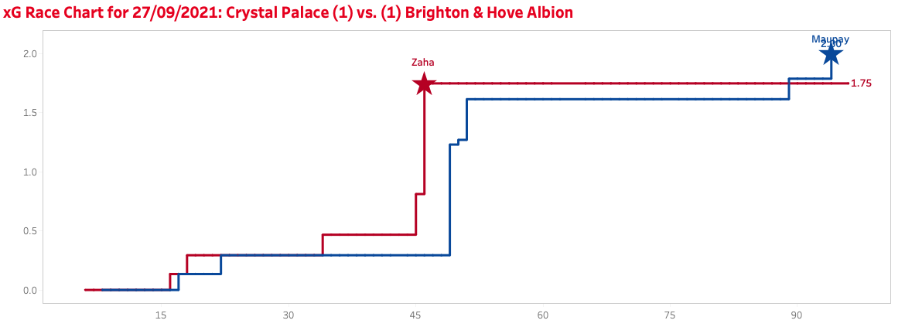
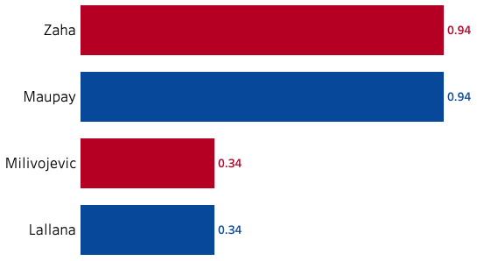
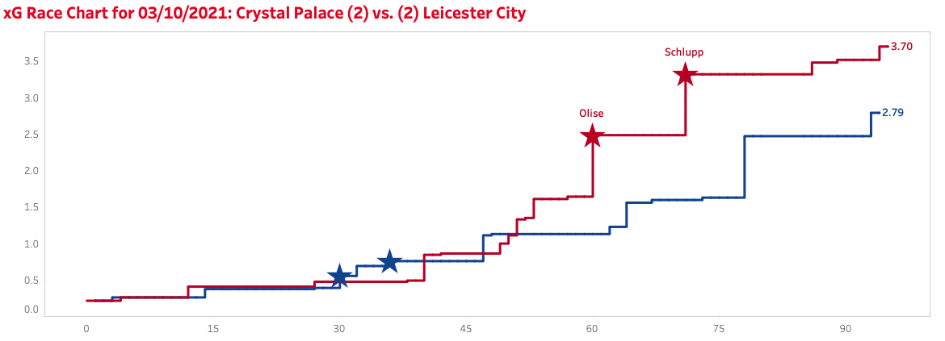
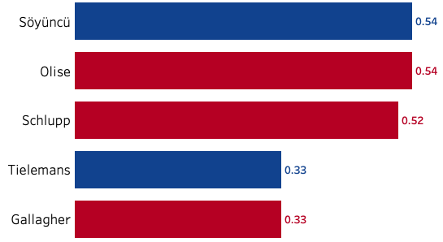
Brighton Was a Tight Contest But Palace Maybe Deserved 3 Points Against Leicester
Assessment of the chances in the match through Expected Goals
Visualisations created in the Player Chance Creation Tableau Dashboard: public.tableau.com/app/profile/edd.webster/viz/EddWebsterWatfordF_C_-CrystalPalaceAnalysisandDashboard/PlayerChanceCreationAnalysisDashboard .
Expected Goals values determined from a model, trained on the Event data of Premier League shots between 2009/10-2020/21. See: nbviewer.org/github/eddwebster/watford/blob/main/notebooks/3_data_modeling/Training%20of%20an%20Expected%20Goals%20Model%20from%20Opta%20Event%20Data.ipynb.
Introduction
P1: Opposition Analysis
P2: Physical Data Analysis
Next Steps
Conclusion
Further Work
References
Appendix
Notes:
The values for Expected Goals were derived by training an Expected Goals model, using shots from the Premier League between 09/10-20/21 by Opta.
The two games are interesting case studies. Against Brighton, Palace were leading the game until a last minute chip from Neil Maupay. However, the chances were level and a draw was probably deserved.
Against Leicester, despite being 2-0 down and coming back to get a point, it could be argued that Palace should have actually gone on to claim all 3 points, when analysing the quality of the chances that they created, especially in the 2nd half, including hitting the bar.

Slide 19

Goals in the Leicester Game
Visualising the four goals in the match using Tracking data
Iheanacho (31' mins) – 0-1
Vardy (37' mins ) – 0-2
Olise (61' mins ) – 1-2
Schlupp (72’ mins) – 2-2
Visualisations created using matplotlib. See: nbviewer.org/github/eddwebster/watford/blob/main/notebooks/4_data_analysis/Second Spectrum Data Visualisation.ipynb
Introduction
P1: Opposition Analysis
P2: Physical Data Analysis
Next Steps
Conclusion
Further Work
References
Appendix

Slide 20
Goals in the Leicester Game…with Pitch Control
Visualising how Palace controlled the space when analysing their chances through Pitch Control
Iheanacho (31' mins)
Vardy (37' mins)
Olise (61' mins)
Schlupp (72 mins)
Pitch Control visualisations created using matplotlib. See: nbviewer.org/github/eddwebster/watford/blob/main/notebooks/4_data_analysis/Second Spectrum Data Visualisation.ipynb.
For more information about Pitch Control, see the Appendix [link] and William Spearman’s 2018 Paper ’Beyond Expected Goals’: www.researchgate.net/publication/327139841_Beyond_Expected_Goals.
Introduction
P1: Opposition Analysis
P2: Physical Data Analysis
Next Steps
Conclusion
Further Work
References
Appendix

Slide 21
Comparing the Footage with Pitch Control
Visualising how Palace controlled the space when analysing their chances through Pitch Control
Olise (61' mins)
Schlupp (72 mins)
Pitch Control visualisations created using matplotlib. See: nbviewer.org/github/eddwebster/watford/blob/main/notebooks/4_data_analysis/Second Spectrum Data Visualisation.ipynb.
For more information about Pitch Control, see the Appendix [link] and William Spearman’s 2018 Paper ’Beyond Expected Goals’: www.researchgate.net/publication/327139841_Beyond_Expected_Goals.
Introduction
P1: Opposition Analysis
P2: Physical Data Analysis
Next Steps
Conclusion
Further Work
References
Appendix

Slide 22
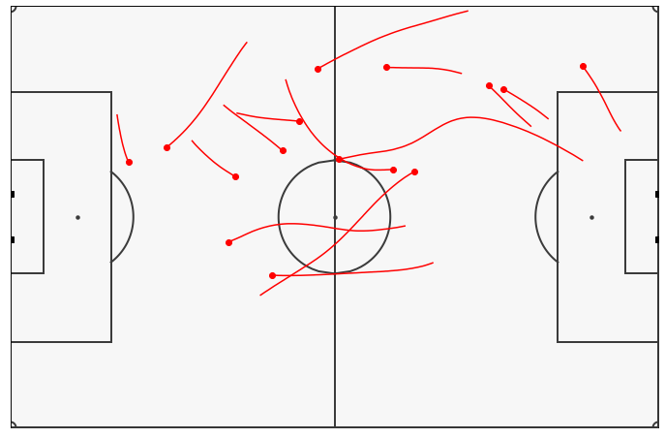
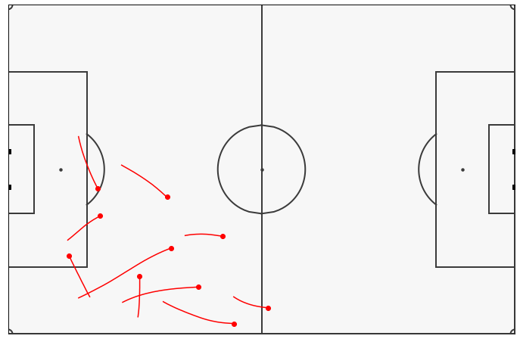
Zaha’s Sprints
Derived from the Tracking data
Shooting from left-to-right
Visualisations created using matplotlib. See: nbviewer.org/github/eddwebster/watford/blob/main/notebooks/4_data_analysis/Second Spectrum Data Visualisation.ipynb
Introduction
P1: Opposition Analysis
P2: Physical Data Analysis
Next Steps
Conclusion
Further Work
References
Appendix

Slide 23
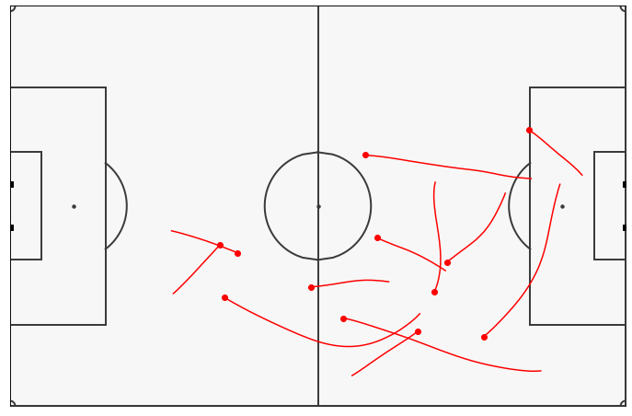
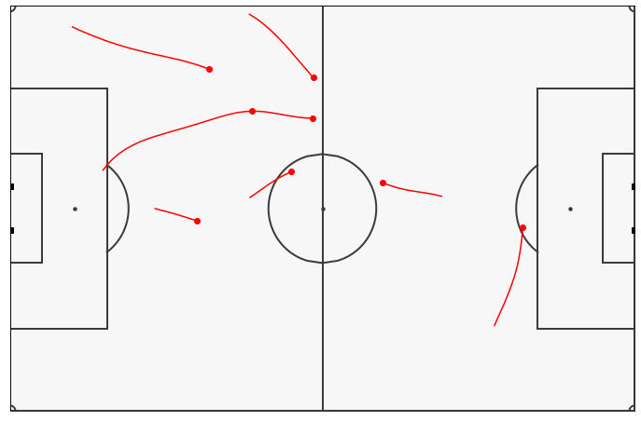
Gallagher’s Sprints
Derived from the Tracking data
Shooting from left-to-right
Visualisations created using matplotlib. See: nbviewer.org/github/eddwebster/watford/blob/main/notebooks/4_data_analysis/Second Spectrum Data Visualisation.ipynb
Introduction
P1: Opposition Analysis
P2: Physical Data Analysis
Next Steps
Conclusion
Further Work
References
Appendix

Slide 24
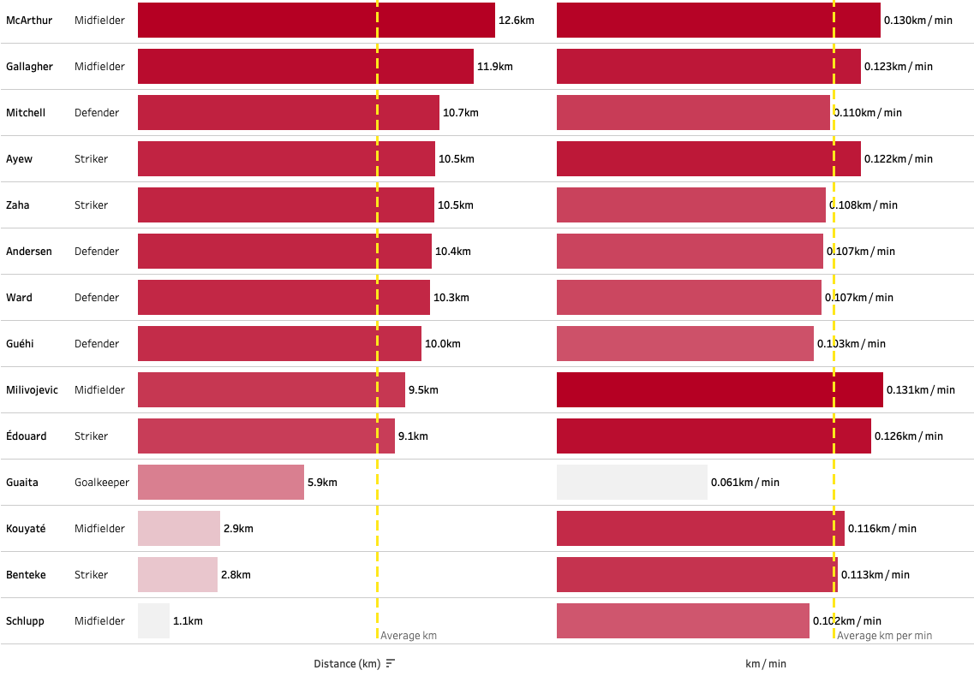
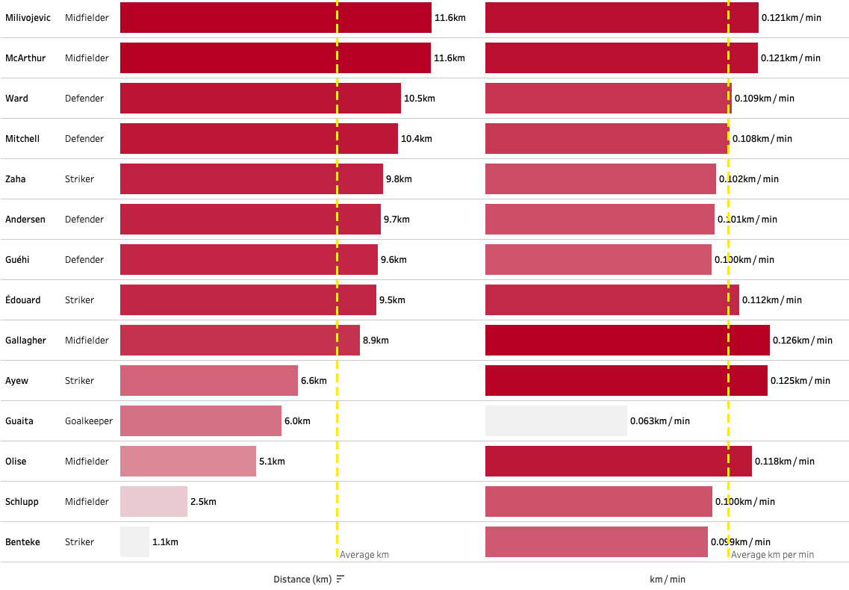
Milivojevic and McArther Covered the Most Ground
Using the tracking data to determine that the two midfielders rank highly for distance covered per match and per minute
Visualisations created in the Physical Report Tableau Dashboard: public.tableau.com/app/profile/edd.webster/viz/EddWebsterWatfordF_C_-CrystalPalaceAnalysisandDashboard/PhysicalReportTotalDistanceDashboard.
Physical data derived from Tracking data.
Introduction
P1: Opposition Analysis
P2: Physical Data Analysis
Next Steps
Conclusion
Further Work
References
Appendix
Notes:
More of these physical reports will be focussed on in the next section, however, it is possible to derive findings from the Tracking data

Slide 25
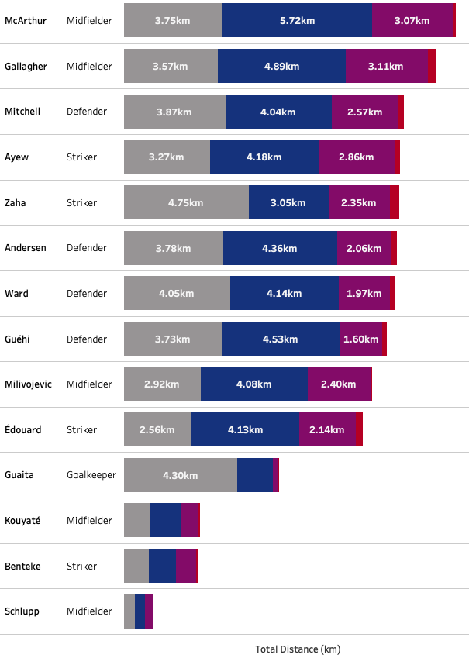
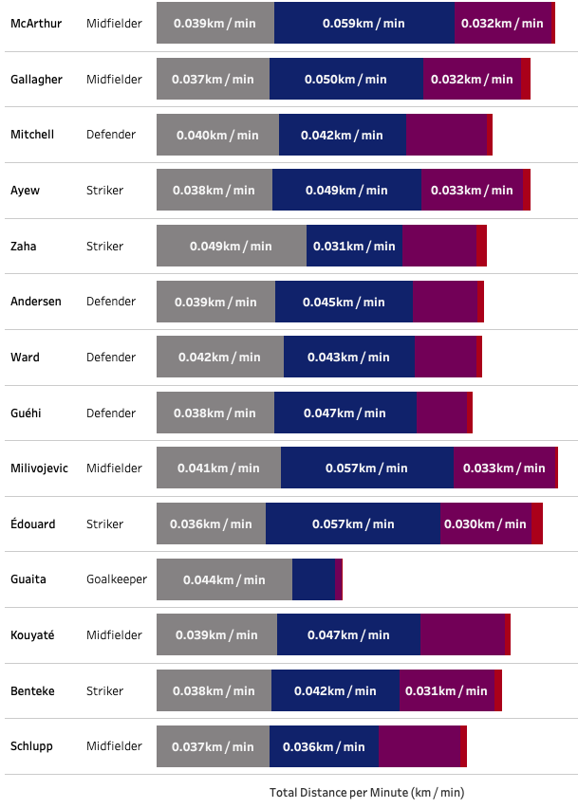
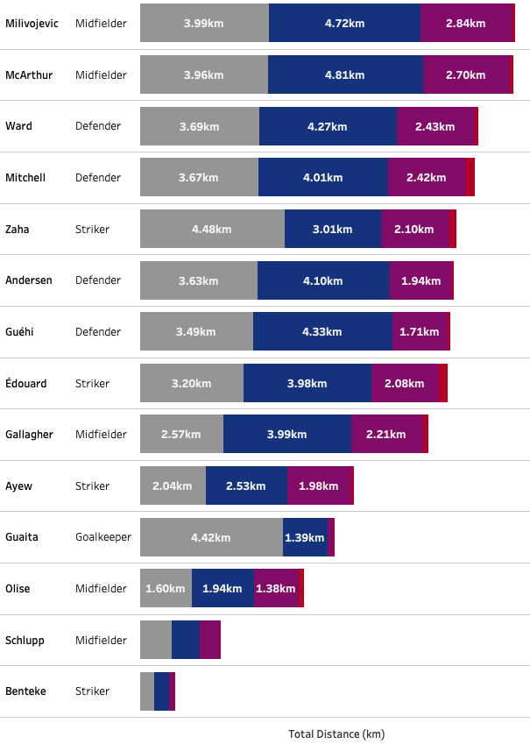
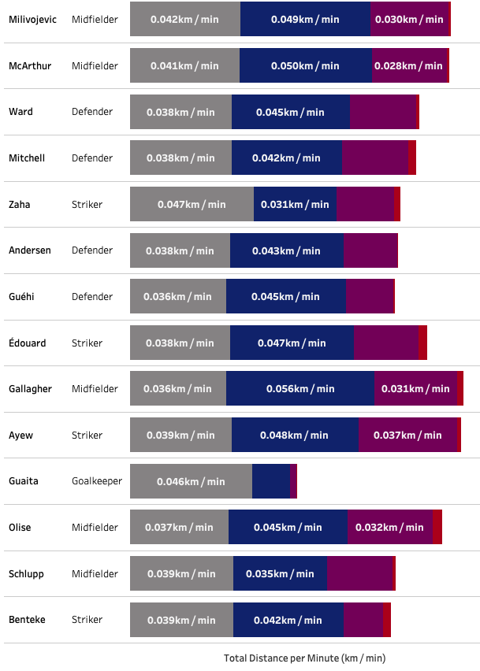
Gallagher, Zaha, ﻿Édouard Conducted the Most Sprints*
With largest datasets, the different run types can be benchmarked against a player’s average performance
Visualisations created in the Physical Report Tableau Dashboard: public.tableau.com/app/profile/edd.webster/viz/EddWebsterWatfordF_C_-CrystalPalaceAnalysisandDashboard/PhysicalReportRunTypesDashboard.
*Both for overall distance covered and per minute.
Run types categorised as: Walking (less than 2m/s), Jogging (2-4 m/s), Running (4-7 m/s), Sprinting (greater than 7 m/s). Greater than 10.44 m/s is faster than Usain Bolt and is treated as a anomalous.
Introduction
P1: Opposition Analysis
P2: Physical Data Analysis
Next Steps
Conclusion
Further Work
References
Appendix

Slide 26
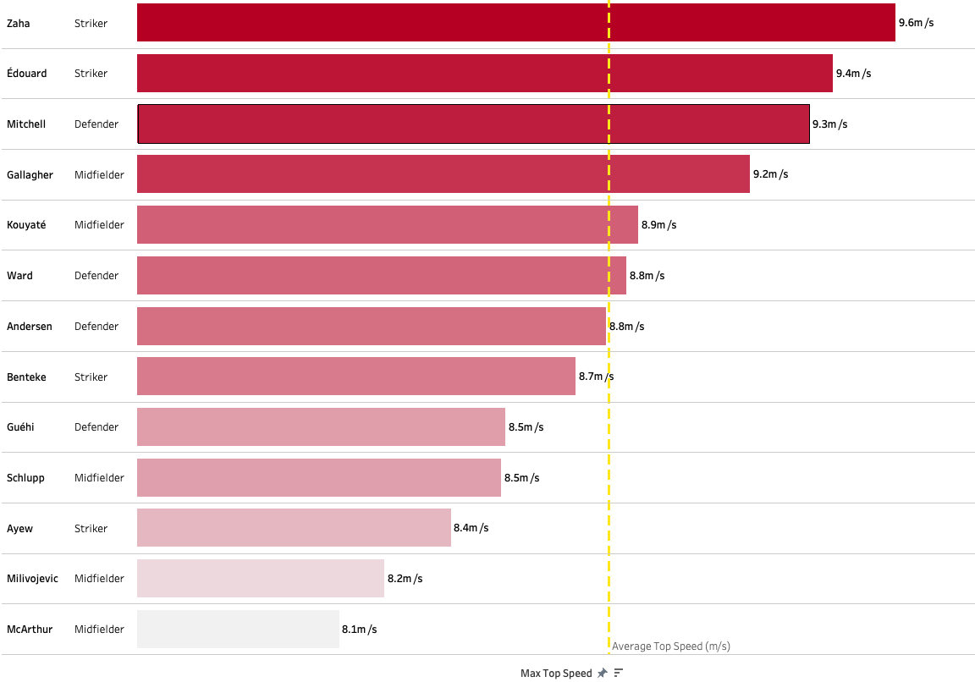
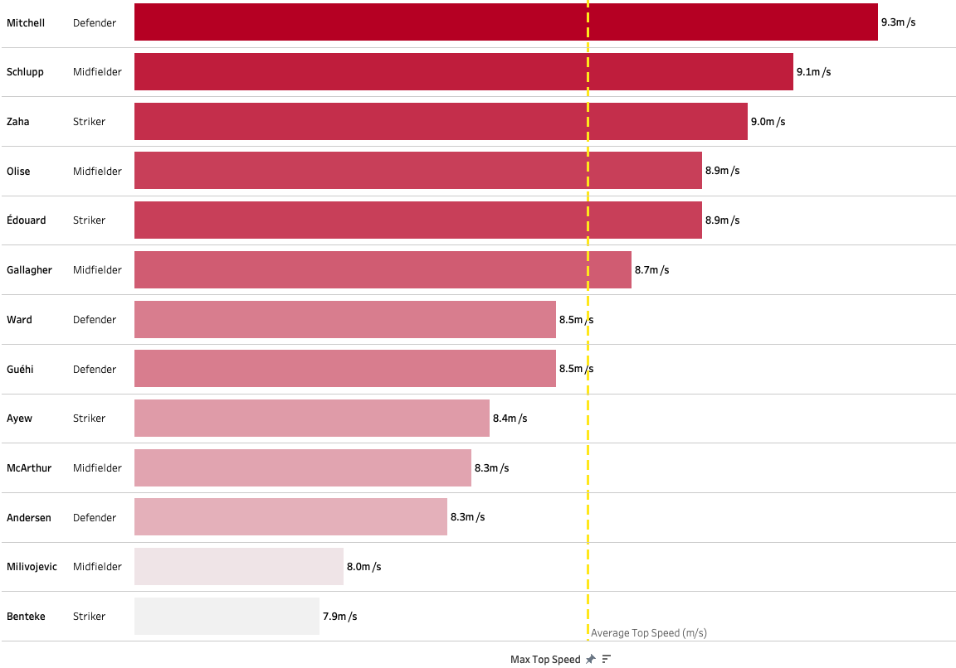
Wilfred Zaha a Danger On The Break*
Closely followed by Odsonne Édouard and Tyrick Mitchell
Visualisations created in the Physical Report Tableau Dashboard: public.tableau.com/app/profile/edd.webster/viz/EddWebsterWatfordF_C_-CrystalPalaceAnalysisandDashboard/PhysicalReportTopSpeedDashboard.
*Wilfred Zaha’s had the fastest recorded sprint during the two matches of 9.6 m/s. Odsonne Édouard has a fastest sprint of 9.4 m/s and Tyrick Mitchell 9.3 m/s.
Introduction
P1: Opposition Analysis
P2: Physical Data Analysis
Next Steps
Conclusion
Further Work
References
Appendix

Slide 27
Key Takeaways
Data-driven insights to provide action insight for football matches
Crystal Palace Prefer to Play a 4-3-3
Prepare the team to combat against this formation
Gallagher is a Creative Threat From Midfield
Match up Crystal Palace in the midfield to prevent one of their main attacking threats, Gallagher, from having time and space on the ball on the right-hand-side of Palace’s three-man midfield
Crystal Palace Look to Stretch the Game from the Left-Hand-Side
Mitchell plays high and wide as the full-back and Zaha is their main outlet from the left wing, especially dangerous on the break with his pace and skill
Introduction
P1: Opposition Analysis
P2: Physical Data Analysis
Next Steps
Conclusion
Further Work
References
Appendix

Slide 28
Physical Data Analysis
using an anonymised CSV output from an historical season, to provide insights on Team A as well as the other teams, where relevant.
Introduction
P1: Opposition Analysis
P2: Physical Data Analysis
Next Steps
Conclusion
Further Work
References
Appendix

Slide 29
Analysis to Answer the Following Questions…
Section aims to derive clear and simple findings
Estimate the player positions by the distribution of run types.
Who are Team A’s quickest players?
Who was the hardest working player?
The players that covered the most and least ground (total distance and meters per minute)
The players that covered the highest and lowest distance with high intensity runs (total distance and meters per minute)
Players that worked hardest off-the-ball (total distance and meters per minute when opponent is in possession)
In which matches did Team A run the most/least?
What are the periods of the match that Team A on average ran the most/least?
Introduction
P1: Opposition Analysis
P2: Physical Data Analysis
Next Steps
Conclusion
Further Work
References
Appendix

Slide 30
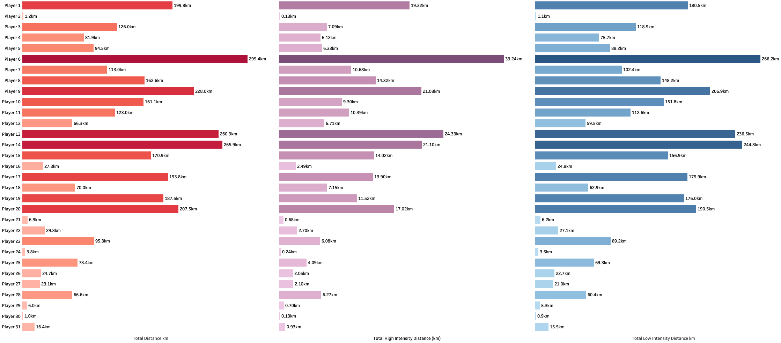
Overview of the Distances Covered by the Players During the Season
Player 6 Covered the Most Distance During the Season, followed by Players 13 and 14
Total Distance (km)
Total High Intensity Distance (km)
Total Low Intensity Distance (km)
Visualisations created in the Player Overview Dashboard: public.tableau.com/app/profile/edd.webster/viz/EddWebsterWatfordF_C_-PhysicalDataAnalysisandDashboards/PlayerOverviewDashboard
Introduction
P1: Opposition Analysis
P2: Physical Data Analysis
Next Steps
Conclusion
Further Work
References
Appendix

Slide 31
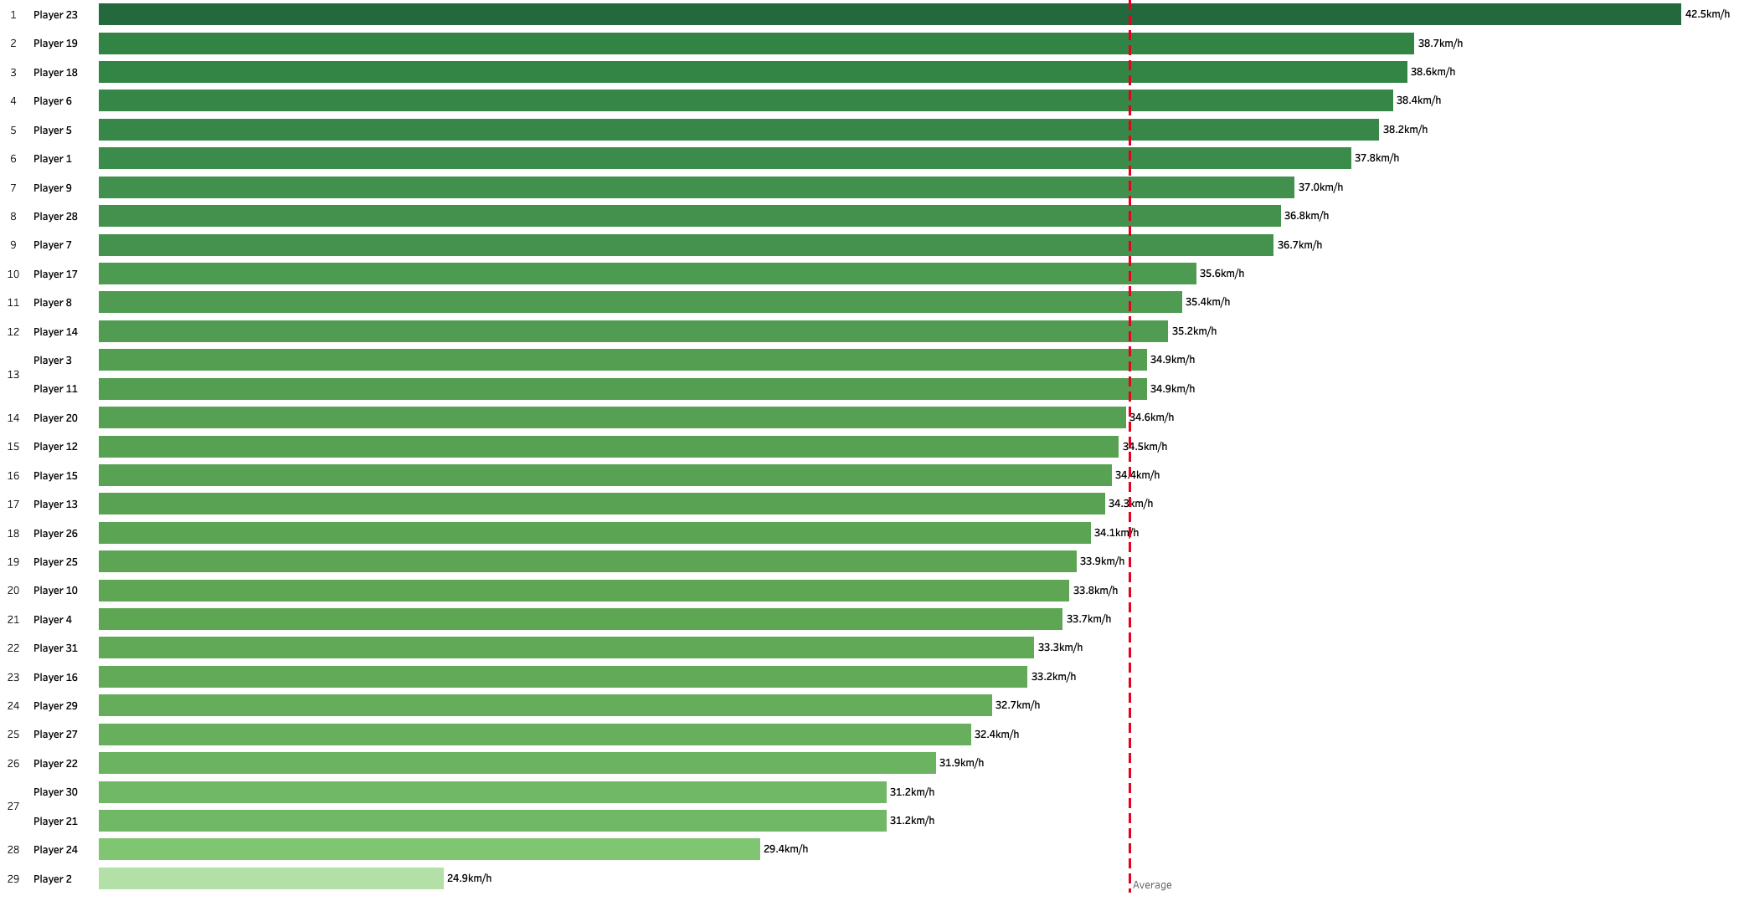
Player 23 is the Quickest Player
Sprint of 42.5 km/h recorded against Team J on 3rd March
Introduction
P1: Opposition Analysis
P2: Physical Data Analysis
Next Steps
Conclusion
Further Work
References
Appendix

Slide 32
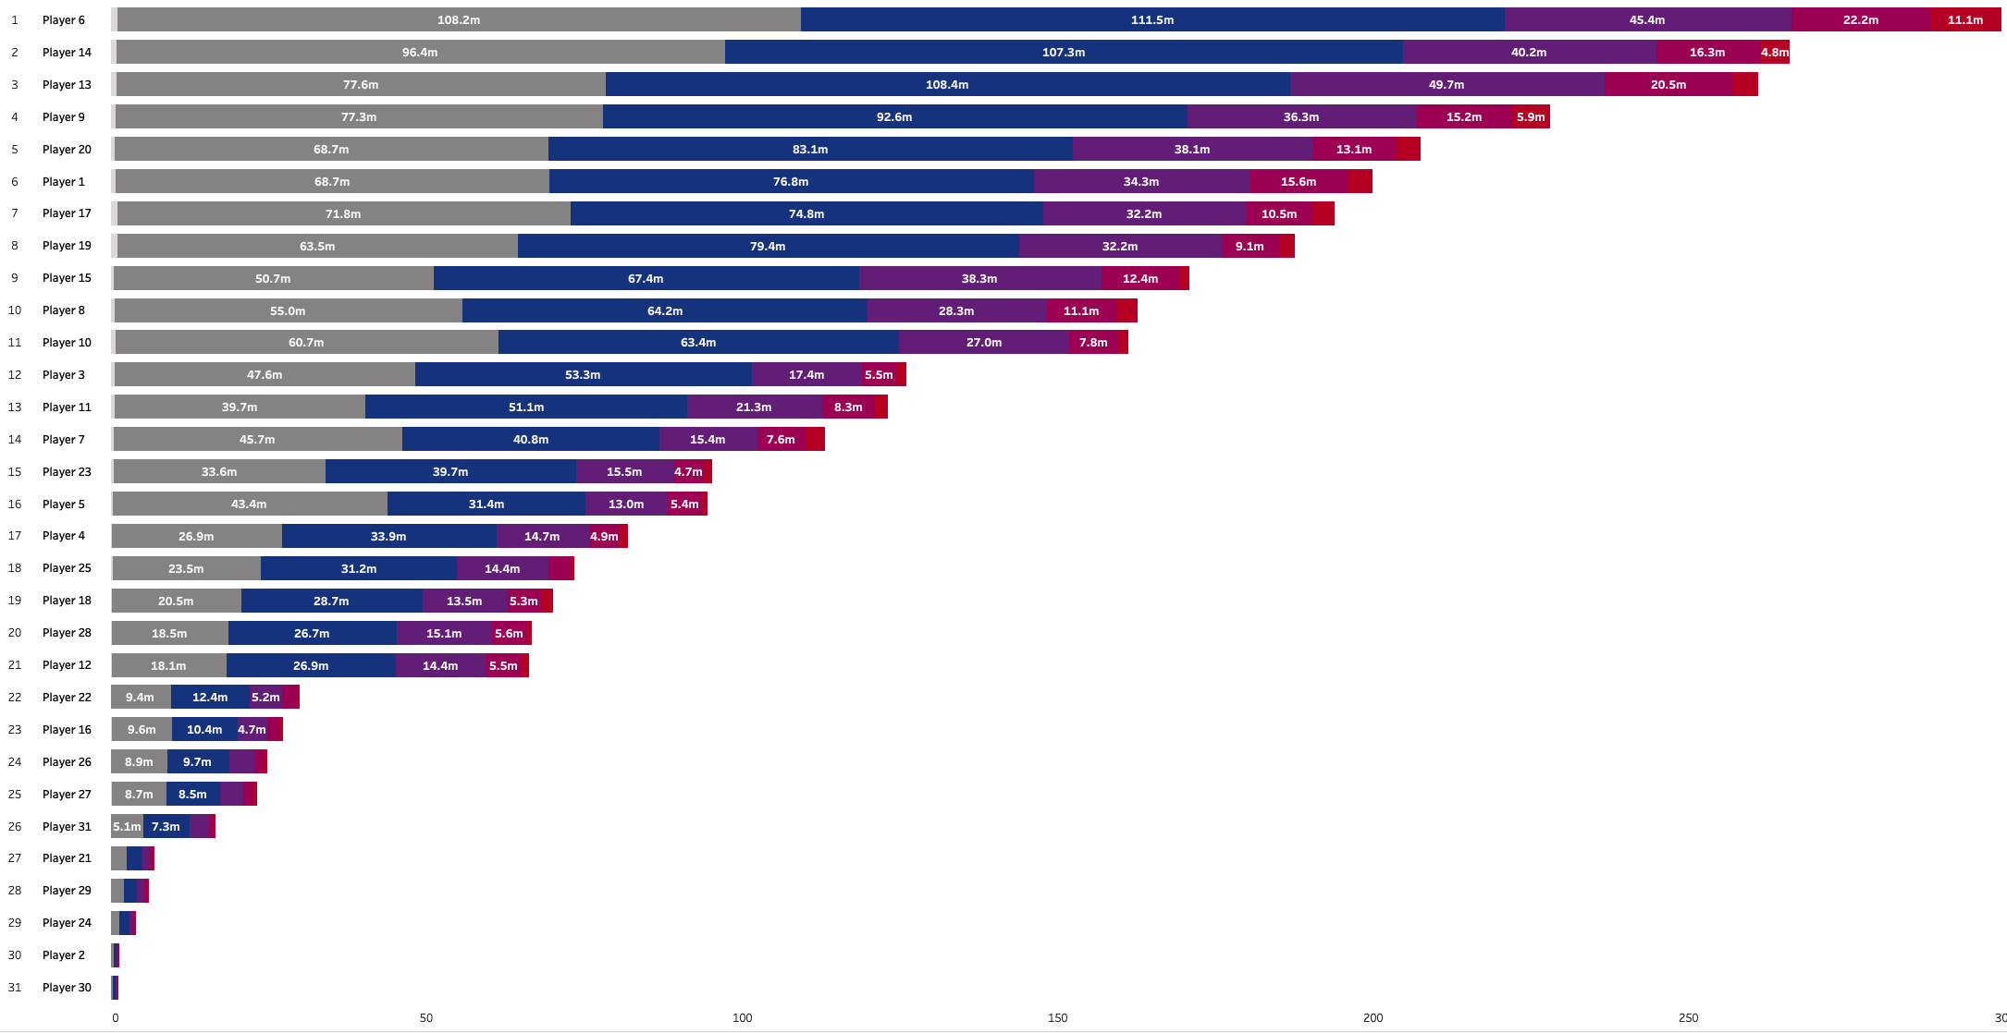
The Attacking Players are Most Likely Players 6, 9, 13, 14, 20
Breakdown of the total distance each player covered by the different run types
Visualisations created in the Physical Data Analysis Total Distance Dashboard: public.tableau.com/app/profile/edd.webster/viz/EddWebsterWatfordF_C_-PhysicalDataAnalysisandDashboards/PhysicalDataAnalysisRunTypesPlayerLevelDashboard .
Five speed modes: standing, walking (under 2 m/s), jogging (2-4 m/s), running (4-5,5 m/s), high speed running (5,5-7 m/s) and sprinting (over 7 m/s).
Introduction
P1: Opposition Analysis
P2: Physical Data Analysis
Next Steps
Conclusion
Further Work
References
Appendix
Notes:
Players 6, 9, 14, 20, 13 ran the greatest distance in sprints
Player 15 probably the goalkeeper – greatest walk:sprint ratio

Slide 33
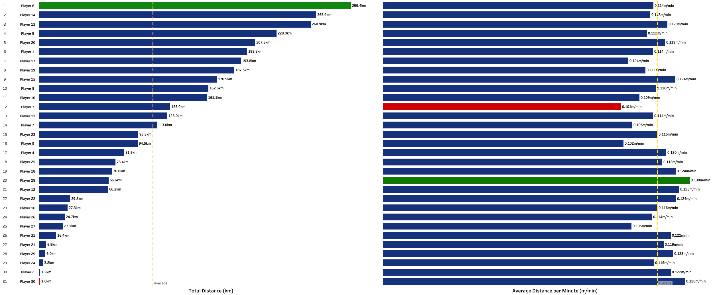
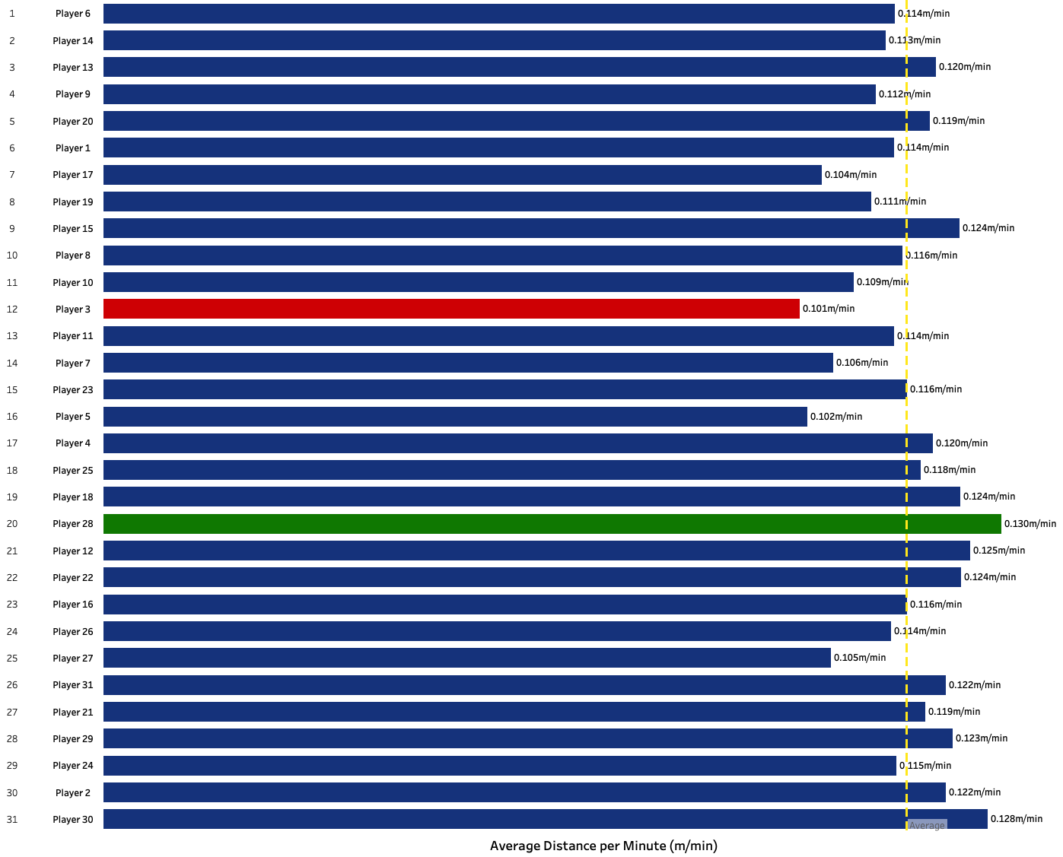
Which Player Worked the Hardest?
Player 6 Covered the Most Distance During the Season whilst Player 28 ran the most meters per minute
Total Distance (km)
Average Distance per Minute (m/min)
Visualisations created in the Physical Data Analysis Total Distance Dashboard: public.tableau.com/app/profile/edd.webster/viz/EddWebsterWatfordF_C_-PhysicalDataAnalysisandDashboards/PhysicalDataAnalysisTotalDistanceDashboard
Introduction
P1: Opposition Analysis
P2: Physical Data Analysis
Next Steps
Conclusion
Further Work
References
Appendix
Notes:
Player 6 covered the most meters over the course of the season, which quickly suggests that they were a starter in most games
Player 28 covered the most meters per minute, however, ranked 20th for total distance covered
Player 3 covered the lowest meters per minute, ranking 12th for distance covered

Slide 34
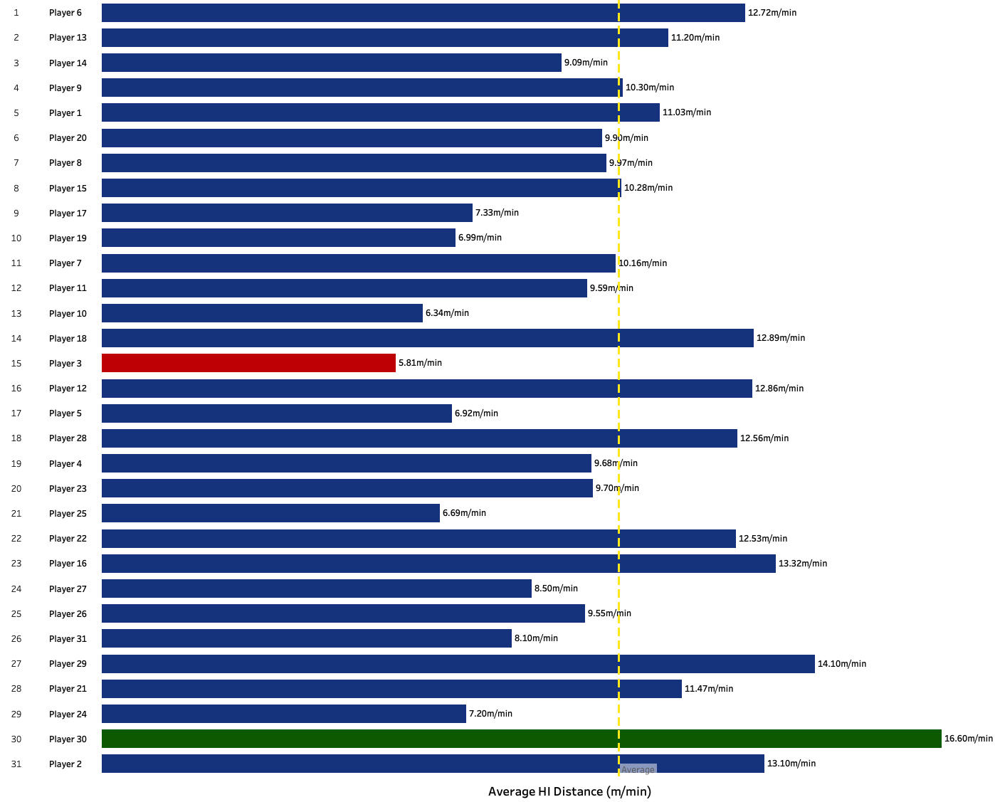
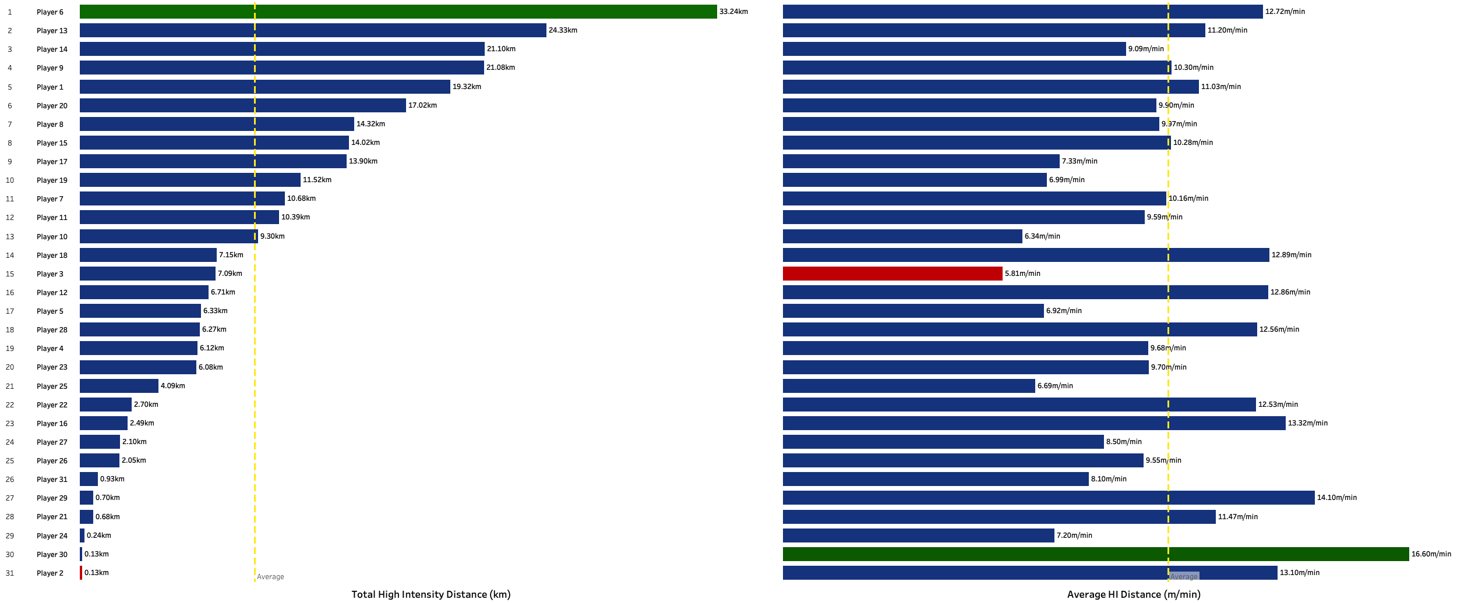
Player 6 Also Had the Greatest High Intensity Distance Covered
Whilst Player 3 had the lowest HI distance per minute, whilst finishing 15th overall
Total Distance (km)
Average High Intensity Distance per Minute (m/min)
Visualisations created in the Physical Data Analysis Total Distance Dashboard: public.tableau.com/app/profile/edd.webster/viz/EddWebsterWatfordF_C_-PhysicalDataAnalysisandDashboards/PhysicalDataAnalysisTotalDistanceDashboard
Introduction
P1: Opposition Analysis
P2: Physical Data Analysis
Next Steps
Conclusion
Further Work
References
Appendix
Notes:
Player 6 also had the greatest High Intensity distance covered – suggesting they’re a striker or winge
Player 3 potentially a goalkeeper?
Players that had next to 0 game time distort the max meters run

Slide 35
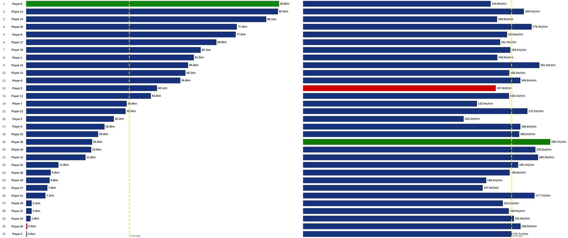
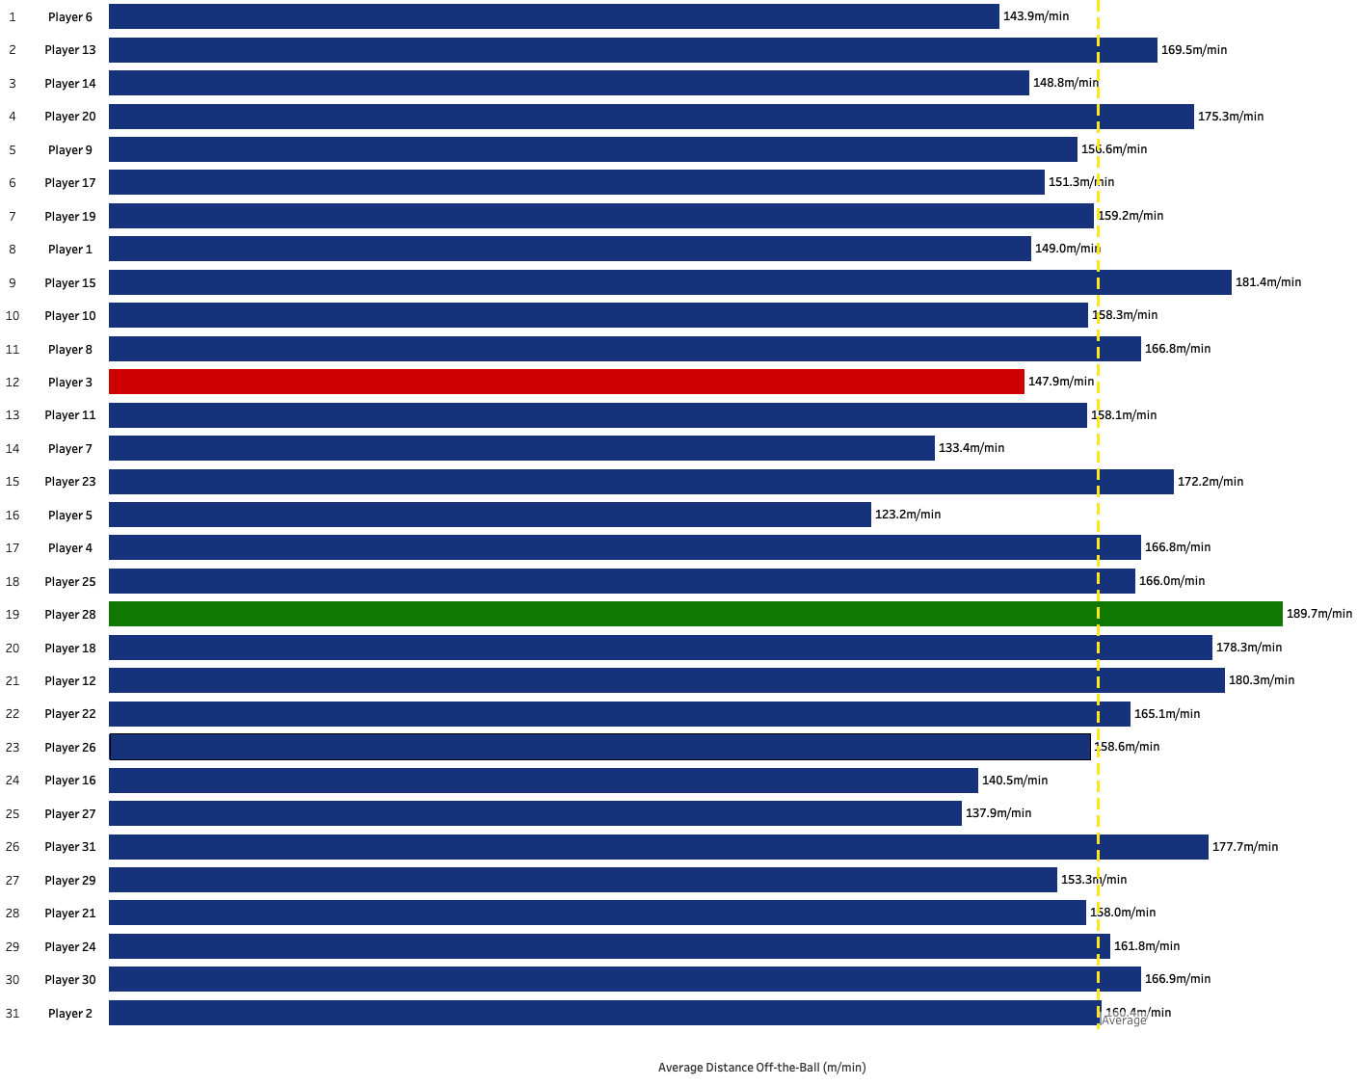
Which Players are Working Hardest Off-the-Ball?
Player 6 comes out top for total distance, however, it’s Player 28 that puts in the most work per minute
Total Distance Off-the-Ball (km)
Average Distance Off-the-Ball (m/min)
Visualisations created in the Physical Data Analysis Total Distance Dashboard: public.tableau.com/app/profile/edd.webster/viz/EddWebsterWatfordF_C_-PhysicalDataAnalysisandDashboards/PhysicalDataAnalysisOff-the-BallTotalDistancePlayerLevelDashboard
Introduction
P1: Opposition Analysis
P2: Physical Data Analysis
Next Steps
Conclusion
Further Work
References
Appendix
Notes:
- Previous determined that Player 6 is most likely an attacking player, therefore, off-the-ball distance per minute will be lower than players such as center midfielders

Slide 36
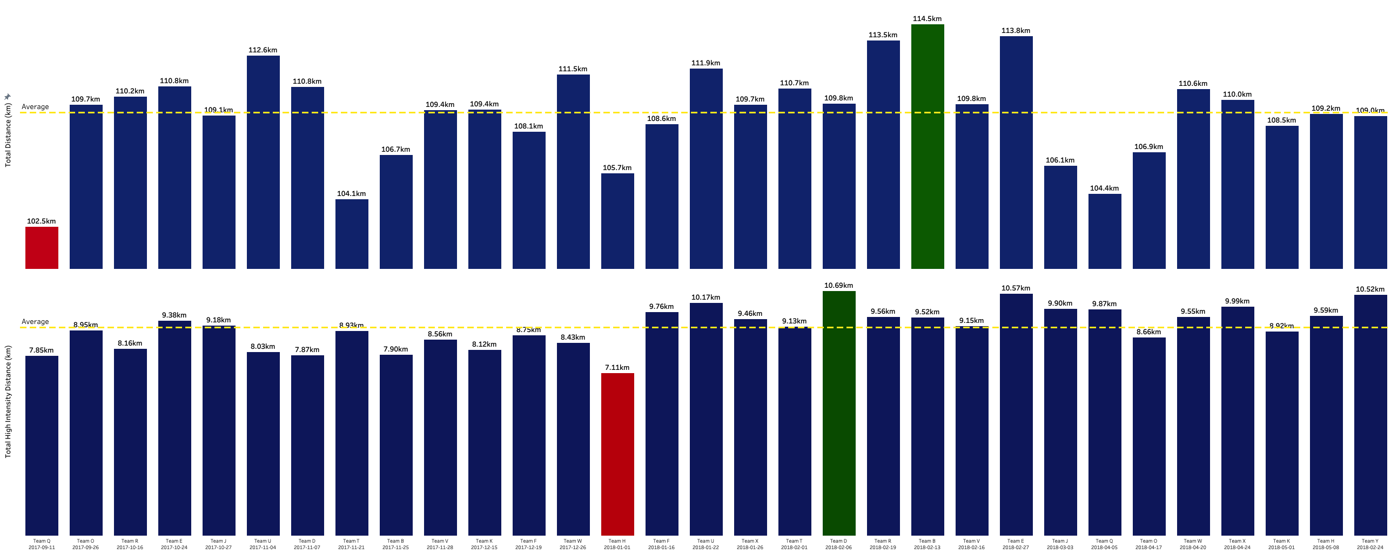
The Most Ground Covered as a Team Was Against Team B
Whilst the greatest distance of high intensity sprints was against Team D
Total Distance (km)
Total High Intensity Distance (km)
Visualisations created in the Physical Data Analysis Total Distance Dashboard: public.tableau.com/app/profile/edd.webster/viz/EddWebsterWatfordF_C_-PhysicalDataAnalysisandDashboards/PhysicalDataAnalysisTeamADistancebyMatchDashboard-BarChart?publish=yes
Introduction
P1: Opposition Analysis
P2: Physical Data Analysis
Next Steps
Conclusion
Further Work
References
Appendix
Notes:
The match where Team A covered the most ground was against team B –midway through the season on 13th February
The lowest ground covered was in the season opener (11th September)
For High Intensity distance covered, the lowest was on 1st January, during a busy Christmas period where they had play a game 5 days earlier
The match with the greatest High Intensity distance covered was against Team D on 6th February

Slide 37
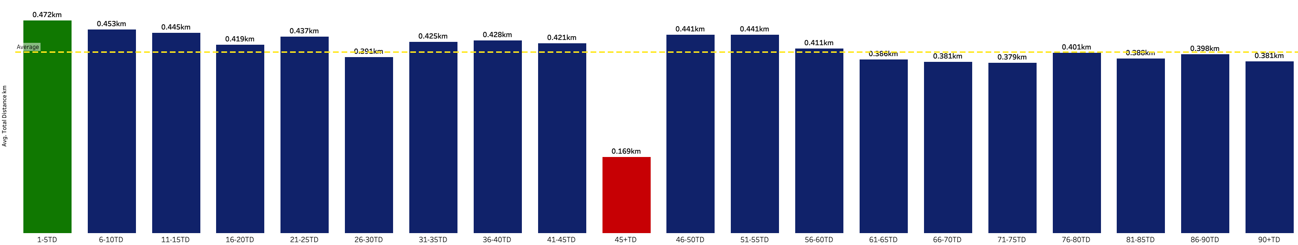
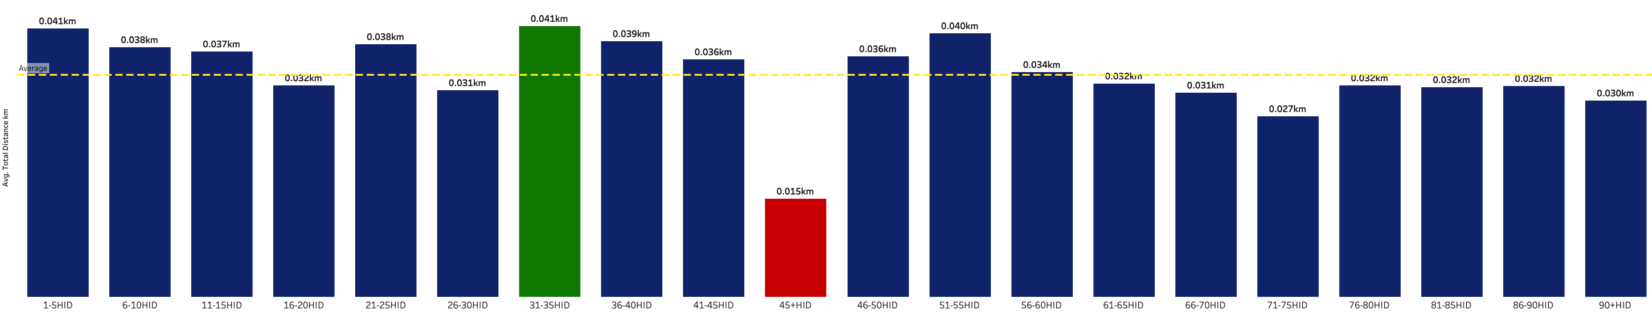
High Intensity Distance is Greatest Between Minutes 31-35
Mins 71-75 is when the High Intensity distance drops off
Average Distance per Player per 5 mins (km)
Average High Intensity Distance per Player per 5 mins (km)
Visualisations created in the Physical Data Analysis Total Distance Dashboard:
Introduction
P1: Opposition Analysis
P2: Physical Data Analysis
Next Steps
Conclusion
Further Work
References
Appendix
Notes:
71-75

Slide 38
Key Takeaways
Data-driven insights to provide action insight of player physical data
Players 6, 7, 13, 14, and 20 are Most Likely the Attacking Players
The players that had the greatest highest sprint distance during the season
Minutes 71-75 is When Team A are the Most Tired
Lowest average high intensity sprint distance over 90 minutes
Player 6 is the Hardest Working Player
Both in terms of total distance covered and high intensity distance, however, Player 28 covers the most meters per minute when on the field
Introduction
P1: Opposition Analysis
P2: Physical Data Analysis
Next Steps
Conclusion
Further Work
References
Appendix

Slide 39
Next Steps
Introduction
P1: Opposition Analysis
P2: Physical Data Analysis
Next Steps
Conclusion
Further Work
References
Appendix

Slide 40
Possibilities and Next Steps of this Analytical Piece
Some of the steps I plan/wish to take given more time and resources
1
Continue to work with the Tracking data to derive further tactical insight such as formation analysis of the teams in- and out-of-possession, set piece analysis of corner and free kick routine from Event and Tracking data – are there patterns in where Crystal Palace deliver the first ball and can the patterns in their zonal and man marking be detected from the Tracking data. For an example of this, see: ’Routine Inspection: Measuring Playbooks for Corner Kicks’ by Laurie Shaw and Sudarshan Gopaladesikan.
Benchmark the physical performance of the Crystal Palace players for the total distance covered, sprints, runs, etc., against data for the full season, to observe the matches where performance excelled or dropped off.
Derive improved Expected Goals (xG) and Expected Threat (xT) / Action Value framework models through the application of tracking data (at least a full season), which provides additional information including the positions of all players off-the-ball, one of the issues that cause such models to favour attackers that are on-the-ball.
Match today the Event data and Tracking data for visualisation and analysis at the same time.
Pitch Control modeling not of just the goals but all the key chances in the game, that can be determined in an automated fashion for the most relevant, dangerous passages of play, using xT and xG.
2
3
4
5
Introduction
P1: Opposition Analysis
P2: Physical Data Analysis
Next Steps
Conclusion
Further Work
References
Appendix

Slide 41
Conclusion
Introduction
P1: Opposition Analysis
P2: Physical Data Analysis
Next Steps
Conclusion
Further Work
References
Appendix

Slide 42
Conclusion of this Data Analysis Pack
Insight this deck aims to provide
1
This deck demonstrates data-driven analysis of opposition data and physical data, to show some of the ways that data can help facilitate the analysis of football.
This tools and analysis in this deck work from first principles, starting from the parsing of XML and JSON files for Event and Tracking data, followed by data engineering, visualisation, and analysis in a footballing context, to provide a sample of actionable insight capable with data-driven analysis.
The strong knowledge and understanding of the application of data science methods and football analytics that I possess, to analyse and provide data-driven recommendations through clear communication, that I can bring to Watford Football Club as a Data Scientist.
2
3
Introduction
P1: Opposition Analysis
P2: Physical Data Analysis
Next Steps
Conclusion
Further Work
References
Appendix

Slide 43

For More Information
If you would like to find out more…
CV: docs.google.com/document/d/1rx1L4TBQvCrYgxvLWHWqkIqJuEyvwQ5NaauhpXTljqQ
Football Analytics GitHub (code): github.com/eddwebster/football_analytics
Google Drive (code + data): drive.google.com/drive/folders/1yofRp9536WnRL7NKJa5XYjv1vJvDYVbi
Slides:
Football Analysis Portfolio (submitted with initial application): docs.google.com/presentation/d/1LVMJlDDDG8MG-IXpE135mvfb4xRbQydN8BX60xDz6NY
Data Task (this deck): docs.google.com/presentation/d/1P8Ae7Bcv3VxXEC-serbn3qCLuprZ0UDfhFxqWeO_3eo
Tableau:
Public Profile: public.tableau.com/profile/edd.webster.
Dashboards:
2018 FIFA Men’s World Cup Center Back analysis: public.tableau.com/app/profile/edd.webster/viz/EddWebster-WorldCup2018AnalysisandDashboard/WC2018PlayerDashboard
FA WSL 18/19 and 19/20 analysis: public.tableau.com/app/profile/edd.webster/viz/EddWebster-FAWSLAnalysisandDashboard/WSLxGAnalysisDashboard
‘Big 5’ European Leagues analysis: public.tableau.com/app/profile/edd.webster/viz/EddWebster-Big5EuropeanLeagueAnalysisandDashboards/Big5ScoutingDashboard
Website: eddwebster.com
LinkedIn: linkedin.com/in/eddwebster
Twitter: @eddwebster
Email: edd.j.webster@gmail.com
Introduction
P1: Opposition Analysis
P2: Physical Data Analysis
Next Steps
Conclusion
Further Work
References
Appendix

Slide 44
Code
All the notebooks and code behind the scenes that was written to create this analysis
Data Parsing: github.com/eddwebster/watford/tree/main/notebooks/1_data_parsing
Opta F24: github.com/eddwebster/watford/blob/main/notebooks/1_data_parsing/Opta/Parse%20Opta%20F24.R
Opta F7: github.com/eddwebster/watford/blob/main/notebooks/1_data_parsing/Opta/Parse%20Opta%20F7.R
Data Engineering: github.com/eddwebster/watford/tree/main/notebooks/2_data_engineering
Opta Data Engineering: nbviewer.org/github/eddwebster/watford/blob/main/notebooks/2_data_engineering/Opta%20Data%20Engineering.ipynb
Second Spectrum Data Parsing and Engineering: nbviewer.org/github/eddwebster/watford/blob/main/notebooks/2_data_engineering/Second%20Spectrum%20Data%20Engineering.ipynb
Physical Data Engineering: nbviewer.org/github/eddwebster/watford/blob/main/notebooks/2_data_engineering/Physical%20Data%20Engineering.ipynb
Data Modeling: github.com/eddwebster/watford/tree/main/notebooks/3_data_modeling
Training of an Expected Goals Model from Opta Event Data: nbviewer.org/github/eddwebster/watford/blob/main/notebooks/3_data_modeling/Training%20of%20an%20Expected%20Goals%20Model%20from%20Opta%20Event%20Data.ipynb
Data Analysis: github.com/eddwebster/watford/tree/main/notebooks/4_data_analysis
Second Spectrum Data Visualisation: nbviewer.org/github/eddwebster/watford/blob/main/notebooks/4_data_analysis/Second%20Spectrum%20Data%20Visualisation.ipynb
Second Spectrum Tracking Data Scripts:
IO (Data Engineering): github.com/eddwebster/watford/blob/main/scripts/second_spectrum/Second_Spectrum_IO.py
Velocities: github.com/eddwebster/watford/blob/main/scripts/second_spectrum/Second_Spectrum_Velocities.py
Viz: github.com/eddwebster/watford/blob/main/scripts/second_spectrum/Second_Spectrum_Viz.py
Pitch Control: github.com/eddwebster/watford/blob/main/scripts/second_spectrum/Second_Spectrum_PitchControl.py
Introduction
P1: Opposition Analysis
P2: Physical Data Analysis
Next Steps
Conclusion
Further Work
References
Appendix

Slide 45
Dashboards
Links to each individual dashboard, that can also be downloaded two workbooks
Crystal Palace Opposition Analysis:
Form Guide: public.tableau.com/app/profile/edd.webster/viz/EddWebsterWatfordF_C_-CrystalPalaceAnalysisandDashboard/FormGuideDashboard
Squad List: public.tableau.com/app/profile/edd.webster/viz/EddWebsterWatfordF_C_-CrystalPalaceAnalysisandDashboard/SquadListDashboard
xG Analysis Dashboard: public.tableau.com/app/profile/edd.webster/viz/EddWebsterWatfordF_C_-CrystalPalaceAnalysisandDashboard/xGAnalysisDashboard
Player Chance Creation Analysis: public.tableau.com/app/profile/edd.webster/viz/EddWebsterWatfordF_C_-CrystalPalaceAnalysisandDashboard/PlayerChanceCreationAnalysisDashboard
Team Chance Creation Analysis: public.tableau.com/app/profile/edd.webster/viz/EddWebsterWatfordF_C_-CrystalPalaceAnalysisandDashboard/TeamChanceCreationAnalysisDashboard
Average Player Position: public.tableau.com/app/profile/edd.webster/viz/EddWebsterWatfordF_C_-CrystalPalaceAnalysisandDashboard/AveragePlayerPositionDashboard
xT Analysis: public.tableau.com/app/profile/edd.webster/viz/EddWebsterWatfordF_C_-CrystalPalaceAnalysisandDashboard/xTAnalysisDashboard
Touch Heat Map: public.tableau.com/app/profile/edd.webster/viz/EddWebsterWatfordF_C_-CrystalPalaceAnalysisandDashboard/TouchMapDashboard
Passing Network: public.tableau.com/app/profile/edd.webster/viz/EddWebsterWatfordF_C_-CrystalPalaceAnalysisandDashboard/PassingNetworkDashboard
Passing Analysis: public.tableau.com/app/profile/edd.webster/viz/EddWebsterWatfordF_C_-CrystalPalaceAnalysisandDashboard/PassingAnalysisDashboard
Formation Analysis: public.tableau.com/app/profile/edd.webster/viz/EddWebsterWatfordF_C_-CrystalPalaceAnalysisandDashboard/FormationAnalysisDashboard
Physical Reports
Total Distance: public.tableau.com/app/profile/edd.webster/viz/EddWebsterWatfordF_C_-CrystalPalaceAnalysisandDashboard/PhysicalReportTotalDistanceDashboard
Run Types: public.tableau.com/app/profile/edd.webster/viz/EddWebsterWatfordF_C_-CrystalPalaceAnalysisandDashboard/PhysicalReportRunTypesDashboard
Run Types per Minute: public.tableau.com/app/profile/edd.webster/viz/EddWebsterWatfordF_C_-CrystalPalaceAnalysisandDashboard/PhysicalReportRunTypesPerMinuteDashboard
Top Speed: public.tableau.com/app/profile/edd.webster/viz/EddWebsterWatfordF_C_-CrystalPalaceAnalysisandDashboard/PhysicalReportTopSpeedDashboard
Physical Data Analysis:
Total Distance: public.tableau.com/app/profile/edd.webster/viz/EddWebsterWatfordF_C_-PhysicalDataAnalysisandDashboards/PhysicalDataAnalysisTotalDistanceDashboard
Total Distance - Run Types: public.tableau.com/app/profile/edd.webster/viz/EddWebsterWatfordF_C_-PhysicalDataAnalysisandDashboards/PhysicalDataAnalysisRunTypesDashboard
Total Distance - Run Types per Minute: public.tableau.com/app/profile/edd.webster/viz/EddWebsterWatfordF_C_-PhysicalDataAnalysisandDashboards/PhysicalDataAnalysisRunTypesPerMinuteDashboard
Top Speed:
Introduction
P1: Opposition Analysis
P2: Physical Data Analysis
Next Steps
Conclusion
Further Work
References
Appendix

Slide 46

Further Work
Introduction
P1: Opposition Analysis
P2: Physical Data Analysis
Next Steps
Conclusion
Further Work
References
Appendix

Slide 47








Additional Football Analysis Projects 1/2
A selection of reporting tools created in Tableau, to enable data-driven insight to all-levels of a club
Tableau Public profile: public.tableau.com/profile/edd.webster.
Introduction
P1: Opposition Analysis
P2: Physical Data Analysis
Next Steps
Conclusion
Further Work
References
Appendix
Notes:
–

Slide 48



Additional Football Analysis Projects 2/2
Links to additional projects that demonstrate a broad range of tools, skills and analysis when working with football data
Recruitment Analysis of Center Backs
Summary: Scenario for data-driven scouting and recruitment, to find ”the next Gerard Piqué” for a newly promoted club in the ‘Big 5’ European leagues for the 21/22 season. This analysis uses PCA and K-Means clustering to identify playing styles of center backs, from which suitable recommendations are made based on player performance, age, playing time, and budgetary restrictions.
Slides: docs.google.com/presentation/d/1LVMJlDDDG8MG-IXpE135mvfb4xRbQydN8BX60xDz6NY (43-70)
Notebooks: nbviewer.org/github/eddwebster/football_analytics/blob/master/notebooks/5_data_analysis_and_projects/player_similarity_and_clustering/PCA%20and%20K-Means%20Clustering%20of%20%27Pique%CC%81-like%27%20Defenders.ipynb
Expected Goals Modeling
Summary: xG model trained from a dataset of 11,000 shots. Subsequent model applied to a separate dataset derived from tracking data, to analyse team performance in a match.
Slides: docs.google.com/presentation/d/1LVMJlDDDG8MG-IXpE135mvfb4xRbQydN8BX60xDz6NY (82-106
Notebooks: nbviewer.jupyter.org/github/eddwebster/football_analytics/blob/master/notebooks/5_data_analysis_and_projects/xg_modeling/shots_dataset/chance_quality_modelling/1%29%20Logistic%20Regression%20Expected%20Goals%20Model.ipynb
Applications of Tracking Data
Summary: Projects to work with sample Tracking data provided by Metrica Sports and Signality. Applications include: deriving new features to enrich tracking data such as the pressure that players are under and obstructing defenders at the time a shot is taken for use with xG models; deriving performance reports for distance covers, high intensity sprints; as well as applying Pitch Control and Expected Possession Value models.
Slides: docs.google.com/presentation/d/1LVMJlDDDG8MG-IXpE135mvfb4xRbQydN8BX60xDz6NY (71-81)
Notebooks:
Metrics Sports - nbviewer.jupyter.org/github/eddwebster/football_analytics/blob/master/notebooks/5_data_analysis_and_projects/xg_modeling/shots_dataset/metrica-sports/Metrica%20Sports.ipynb
Signality - nbviewer.jupyter.org/github/eddwebster/football_analytics/blob/master/notebooks/5_data_analysis_and_projects/tracking_data/signality/Signality%20Tracking%20Data%20EDA.ipynb
Introduction
P1: Opposition Analysis
P2: Physical Data Analysis
Next Steps
Conclusion
Further Work
References
Appendix

Slide 49
References
Introduction
P1: Opposition Analysis
P2: Physical Data Analysis
Next Steps
Conclusion
Further Work
References
Appendix

Slide 50
References and Further Reading
Data, libraries, graphics, and miscellaneous resources used to create this deck
Data Sources:
JSON file of xT values as a 12x8 grid: karun.in/blog/data/open_xt_12x8_v1.json.
Videos and Webinars:
Tableau for Sport by Rob Carroll: youtube.com/playlist?list=PLchE8bhmmIxK94imJ4QZncXrbld_NGoiW
Graphics:
Tableau pitch templates by James Smith: drive.google.com/drive/folders/1TsD5_l3VFlZd0C-APggu3ERHNA9dnjKk Accompanying Medium blog post: medium.com/analytics-vidhya/how-to-create-football-pitches-goals-as-backgrounds-in-tableau-7b1a7800ae1c
Research:
Beyond Expected Goals by William Spearman: www.researchgate.net/publication/327139841_Beyond_Expected_Goals
Python Libraries:
pandas
Matplotlib
Plotly
Beautiful Soup
Record Linkage
scikit-learn
Custom Football Libraries:
FC,rSTATS: www.fcrstats.com/fcrstats_package.html. Parse F24 data: github.com/FCrSTATS/OptaEventData/blob/master/optaparse7.md
Resources:
Football Formations and Strategies eBook by Russell Pope: drive.google.com/file/d/1pLAETNVUf4Qwe5jRasCUNdxwVgngEiOK/
Concise list of publicly available Football Analytics resources by Edd Webster: github.com/eddwebster/football_analytics
Introduction
P1: Opposition Analysis
P2: Physical Data Analysis
Next Steps
Conclusion
Further Work
References
Appendix

Slide 51
Appendix
Introduction
P1: Opposition Analysis
P2: Physical Data Analysis
Next Steps
Conclusion
Further Work
References
Appendix

Slide 52
Advantages and Challenges of Event data
Pros and cons of the application of Event data for the analysis of football matches
Advantages
Challenges and Limitations
Widely available for hundred of competitions from a variety of providers – StatsBomb, Wyscout, Opta.
Increasingly information rich – new metrics included each season i.e. StatsBomb ‘Freeze Frame’ metric and their recently announced 360 update [link] that will collect the position of all players on camera for every event recorded.
Publicly available Event data has been available for a few years, leading to a number of libraries and repositories including socceraction (Python) by SciSports and ggsoccer (R) by Ben Torvaney.
Easier to process and analyse than Tracking data. Only one event at a time and non-continuous. Size of the data is just 10³ rows.
Easy to connect Event data to video e.g. drag and drop an Opta F24 XML feed to SportsCode and query the video using Event data.
Different providers have different interpretations of actions and accuracies of moments analysed. Subsequently, these datasets require different treatments. Libraries are available to transform data to a uniform standard such as SciSports SPADL format.
Event stream is not always optimised for analysis.
Event data is missing a lot of contextual information when compared with Tracking data as it only accounts for on-the-ball actions. Fewer than 1% of the on-the-ball actions in a football match are shots and players only have the ball 3 minutes on average (Johan Cruyff)¹. Event data is unable to answer the questions as to what the players are doing during the 87 minutes when you do not have the ball.
Not always pleasant to work with in its native form e.g. nested JSON dictionaries.
¹Johan Cruyff quote features in both Javier Fernández and Luke Bornn’s paper ‘Wide Open Spaces: A statistical technique for measuring space creation in professional soccer’.
Advantages and challenges of Tracking data discussed in Sam Gregory and Devin Pleuler’s Sport Logiq webinair on 4th November 2019 ‘Demystifying Tracking Data’. See the following link for this seminar on YouTube: youtube.com/watch?v=miEWHSTYvX4.
Introduction
P1: Opposition Analysis
P2: Physical Data Analysis
Next Steps
Conclusion
Further Work
References
Appendix

Slide 53
Advantages and Challenges of Tracking data
Pros and cons of the application of Tracking data for the analysis of football matches
Advantages and Possibilities
(many still to be discovered!)
Challenges
Size of the data – Event data is 10³ rows. Tracking data is 10⁶ rows i.e. 95 mins (5,700 seconds) x 26 objects (22 players + 3 referees + ball) x 25 frames per second ≈ 3.7mil observations. This brings issues of both storing and processing the data.
Mathematically more complex to work with.
Despite being the state-of-the-art dataset, Tracking data is still missing significant datapoints including: body pose position (i.e. are they open to receive a pass), the spin of the ball (therefore need to build in uncertainties when determining ball trajectory).
Limited public work - recently changed with the Friends of Tracking initiative + public datasets released by Metrica Sports, Signality, and SkillCorner. However, nearly all public initiatives are presented in journals or conferences and are therefore less accessible and aimed at a different audience to most football practitioners.
Difficult to merge Tracking and Event data. Event data has imperfect timestamps. This is possible through a supervised modelling approached (requires properly annotated dataset) or a rules based logic approach (less accurate but easier to implement).
Difficult to query Tracking data as the data is continuous and the unlike the Event data, the rows continue simultaneously with 26 things at the same time i.e. it’s only possible to show all the passes if you’ve previous defined them.
A much fuller dataset, including off-the-ball information.
Can take into account velocities, accelerations, and variables that provide continuous context, not just over a single frame e.g. a player’s off-the-ball run; the ball trajectory on a shot etc.
Data can provide tactical context from coordinate positions e.g. how many times is player X unmarked; where is the fullback when a transition occurs; provide another example of when event Y occurred, etc.
Tracking data can be used to further enrich corresponding Event data to add further detail and specificity. In the recent StatsBomb 360 launch, Event data will now include the positions of all players for a given event. Other example of data enrichment include through the use of computer vision and Tracking data include:
Is a pass under pressure? – distance based logic based on player in possession;
What passing options did the player in possession have – can be calculated geometrically or more simply through rules-based logic such as no. teammates and opponents in front or behind a player; Improve on existing metrics such as ’Packing¹, which is currently manually collected; and
Defender and goalkeeper positions; percent of the goal covered by the keeper, etc.
¹Packing’ is a metric created by IMPECT that assigns a value to the number of opposition players taken out of the game by a pass or dribble.
Advantages and challenges of Tracking data discussed in Sam Gregory and Devin Pleuler’s Sport Logiq webinair on 4th November 2019 ‘Demystifying Tracking Data’. See the following link for this seminar on YouTube: youtube.com/watch?v=miEWHSTYvX4.
Introduction
P1: Opposition Analysis
P2: Physical Data Analysis
Next Steps
Conclusion
Further Work
References
Appendix

Slide 54
Turning Big Data into Meaningful Insights
How does Tableau achieve this?
1
Simplicity
Deliver clear and concise messages that can be comprehended quickly and concisely.
Enable Control
Dashboard and visualisations need to include filters, tool tips, and actions, that can allow the user (often coaches) to find the insights themselves without the need for programming or dashboard building skills.
Flexibility
Filters, tooltips and actions can allow the user to find the insights themselves.
2
3
Introduction
P1: Opposition Analysis
P2: Physical Data Analysis
Next Steps
Conclusion
Further Work
References
Appendix

Slide 55






Football Insights Analysis Tools Overview
A sample of tools for football analysis created for this task using Tableau
Tableau Public profile: public.tableau.com/profile/edd.webster.
Introduction
P1: Opposition Analysis
P2: Physical Data Analysis
Next Steps
Conclusion
Further Work
References
Appendix

Slide 56


What are Expected Goals and Why is it an Important Metric?
Arguably the most important metric in football analytics so far – Expected Goals
‘Expected goals’, aften abbreviated as 'xG’, is the probability that a shot with defined state will, on average, result in a goal (Fig. A).
Shots in matches are rare and goals are even rarer! On average, each team shoots 12 times per matches (0.4% of a 3,000 Event dataset) resulting in an average of 2.66 goals (Fig. B).
xG allow analysts and statisticians to look an all shots instead of just the goals, which happen around ten times as many times as the goals themselves, making for a much better predictor of goals scored by a team in the medium term (this is explored further in the summary slides of this section).
xG can be used to make smarter decisions on recruitment, tactics, and strategy. For example, when recruiting a striker in good form, xG can be used to see if the player is over-performing or is in fact taking the chances that would be expected.
A
B
Definition of Expected Goals derived from Laurie Shaw’s article: Bodies on the Line: Quantifying how defenders affect chances: eightyfivepoints.blogspot.com/2017/09/bodies-on-line-quantifying-how.html.
Expected Goals images taken from both David Sumpter’s Friend of Tracking lesson: ‘How to Build An Expected Goals Model 1: Data and Model (youtube.com/watch?v=bpjLyFyLlXs) and his book Soccermatics.
Visualisation of the number of shots in a game taken from Lotte Bransen and Jan Van Haaren’s talk ‘How to find the next Frankie de Jong’ for Friends of Tracking: youtube.com/watch?v=w0LX-2UgyXU.
Statistics taken from chapter two of The Numbers Game by Chris Anderson and David Sally and Soccermatics by David Sumpter.
Introduction
P1: Opposition Analysis
P2: Physical Data Analysis
Next Steps
Conclusion
Further Work
References
Appendix

Slide 57




Building the Expected Goals Model
Creating a model from first principles to calculate the probability of a shot resulting in a goal i.e. Expected Goals
Features, $x$
Train model
(Logistic Regression)
Shots dataset (13 seasons of Premier League shots from Opta Event data)
Labels
$$f\left(x\right)=y$$
Features, $x$
$$P(goal|shot, situation)$$
i.e. xG
Event data for 2 Crystal Palace matches
Apply model
Introduction
P1: Opposition Analysis
P2: Physical Data Analysis
Next Steps
Conclusion
Further Work
References
Appendix

Slide 58
Pitch Control Models 1/2
Visualisation of Pitch Control in a 2D space
1 = Home team control
Away Player
1.0
Region controlled by Home Team
Pitch Control Scale
0.5
Home Player
(with velocity vector)
Ball Location
Neutral Region
(area of uncertainty)
Region controlled by Away Team
0 = Away team control
0.0
Visualisation reproduced using Signality Pitch Control model with the explanation from Will Spearman’s 2016 Opta Pro forum seminar titled: ‘Quantifying Pitch Control’ . See PowerPoint: researchgate.net/publication/334849056_Quantifying_Pitch_Control.
Introduction
P1: Opposition Analysis
P2: Physical Data Analysis
Next Steps
Conclusion
Further Work
References
Appendix

Slide 59
Pitch Control Models 2/2
What is Pitch Control? Definitions
Definition of Pitch Control
The Pitch Control Field (PCF) for location x, is defined as the probability that the Home team will end up with possession of the ball if it were at location x. The PCF predicts the team that would be in possession at the next timestep.
Factors of the player’s state that determine the PCT
Location / position
Velocity
Acceleration
Other considerations
Maximum player speed
Time taken for the play to control the ball (a constant of 0.7 seconds)
Applications of Pitch Control
Evaluate passing decisions by looking at how much open space is in front of attackers / behind defenders. Best regions are those where receiving players are in an area of the pitch with a large integrated PCF value.
A new metric of player performance to compare a player’s ability to control the pitch.
Models combined with video footage to visualise both the available space for an attacker in or the defensive players out of position in a moment of play.
Definitions reproduced from Will Spearman’s 2016 Opta Pro forum seminar titled: ‘Quantifying Pitch Control’ . See his presentation: researchgate.net/publication/334849056_Quantifying_Pitch_Control.
Introduction
P1: Opposition Analysis
P2: Physical Data Analysis
Next Steps
Conclusion
Further Work
References
Appendix

Slide 60

Thank You!

